Slide 1
Target Audience
Module #2: IT for Efficient Communications
‘Digital Competences for CSOs and Activists’ Course
16 April 2019
Webinar

Slide 2
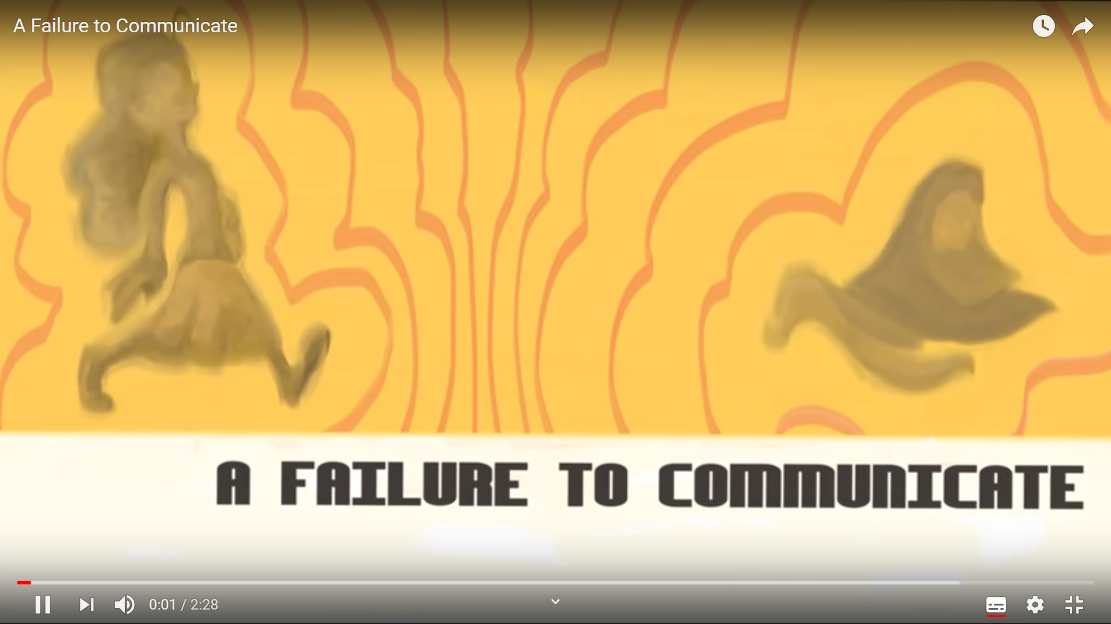
Why shall we (civil society) care?
Webinar
Target Audience
We – civil society, or nonprofits – may not like being compared to for-profit organizations, but with certain aspects we can’t help it.
When it comes to a target audience, we have one just like a for-profit company would.
And odds are, we aren’t reaching ours. Or we do it too late...
https://www.youtube.com/watch?v=8Ox5LhIJSBE

Slide 3
Who do you compete with?
Webinar
Target Audience
You are competing for the same users and their time
with such monster corporations as
Google, Facebook, Mail.Ru, Instagram…
Feel free to continue the list ☺
You
Other online resources run by CSOs in your home town?
Other online resources run by CSOs in your home country?
Other online platforms in your country?
All online platforms?

Slide 4
Think as commercials
Webinar
Target Audience
We are on a constant mission to convince the community that our cause is worth something – when we are applying for grant funding, asking for donations, inviting for lectures or recruiting volunteers.
People will not invest their time or money in something they don’t believe in.
So, how can you get them to believe?
Step 1 is to decide whom you will be talking to: market-oriented organizations, which understand the target audience thoroughly, are the most successful ones.

Slide 5
Circle of supporters
Webinar
Target Audience
Loyalty
Satisfaction
Usage
Consideration
Unaided awareness
Aided awareness
There is a group of people out there who are more likely to support you, and those are the only people who you should be trying to contact.
Example: donation campaign
Regular donators (the loyal ones – your core audience)
Donated ones or signed up for your updates (your TA #1)
Donated or supported other nonprofits (your TA #2)
Never supported any nonprofit (‘cold traffic’)
Brand Pyramid
Based on https://visionone.co.uk/
Notes:
There are four key types of customers in marketing:
Brand fans (loyal)
Potential customers
Customers changing brand
Fans of competing bands

Slide 6
Target audience: simplified version
Webinar
Target Audience
01
Geographical aspect
Up to the region, not only the country
Focus on your target demographic – not everyone!
Prioritizing your target audiences is simple:
What is your nonprofit’s No. 1 goal?
Whose participation do you need to reach your goal?
These are the people that matter most. These are the people you want to focus on reaching.
02
Demographic profile
Age, sex, level of income, family status, children, education, employment, religious belief…
03
Psychographic profile
Values, believes, motivations and personality type. This is especially important for emotionally selling products
04
Behavioural attributes
behaviour patterns in decision making or typical use of the product, eg. how often the person uses the Internet and what for.

Slide 7
Webinar
Target Audience
Target audience: level up
You need to understand who this person is in fact, because your image of a reader or a consumer may differ from the reality
Your target audiences inform everything. They determine what you say, how you say it and where you say it.
To strategically and effectively use these target audiences moving forward, you need to make them real. You need to get inside the head of someone from each of these groups.
This is where audience personas come in.
Irina Levchenko,
media trainer and copywriter, Belarus

Slide 8
Who is the audience persona?
Webinar
Target Audience
A target audience persona outlines a typical member of a target audience. They are fictional representations rooted in behavioral data and knowledge that you’ve gained from getting to know your supporters on a personal level.
Target audience persona development narrows down your target audiences to specific people with faces, names, goals and challenges.
Benefits of using:
Talking to a specific person (or persons) is much easier than to a vague list of data points.
You are helping them to overcome their challenges and achieve goals in regards to your organisation / group.
Three personas cover all of target audiences of a nonprofit.

Slide 9
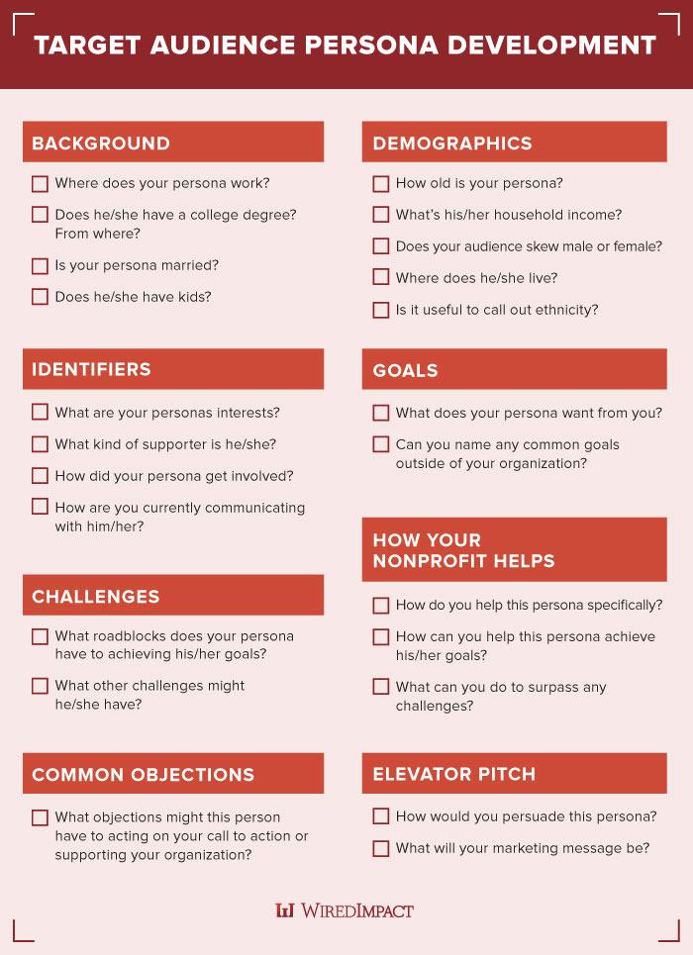
Audience persona checklist
Webinar
Target Audience
Key parameters:
Background (work, education, family).
Demographics (age, income, gender, place, language/s, ethnicity).
Identifiers (interests, supporter, communication)
Goals (the persona’s and yours)
Challenges (regarding the goals and beyond)
How you can help
Common objectives to act on your call
Elevator pitch (marketing message to persuade)
Source: https://wiredimpact.com/

Slide 10

Audience persona: example
Webinar
Target Audience
Anna P. is an accountant in a middle-sized printing house, with a bachelor degree in accounting from the local college. She is 35, married for 10 year, have two kids – a son (9) and a daughter (6). Dual family income is EUR 1,200 / month, but she makes more than her husband. The family owns a 2-bedroom apartment in Tbilisi.
Anna’s husband is very conservative, so she is a busy working mom, who is also in charge of the kids and the household. She used to love painting, but her family insisted on her getting a ‘serious profession’.
Anna wants her children to have a choice she did not have, but is more concerned with her daughter’s future. She wants her son to respect women more.
Her husband does not support her, and she does not have time and energy to fight him. Her children are too young to think about this.
(continue and suggest an organisation to help)

Slide 11
Webinar
Target Audience
Target audience: Top Level
Decisions are 100% emotional. People ‘buy’ experience and feelings, not things.
Marketing formulas:
We [name] promise/reassure/ you will feel [emotion/benefit] using [product], because of its [feature]
Or
To [target market]. [Product] is the [category frame of reference] that [rational / emotional benefit / promise]. That’s because [reason to believe].
Notes:
Or in 80%, according to Roger Dooley and his ‘Brainfluence: 100 Ways to Persuade and Convince Consumers with Neuromarketing’ book

Slide 12
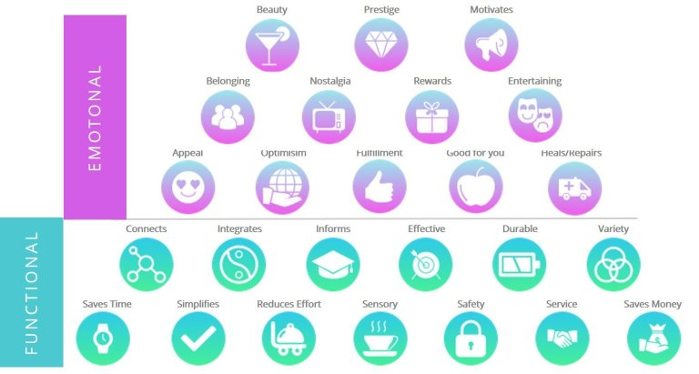
Two levels of benefits
Webinar
Target Audience
Functional benefit: This is the direct solution that the brand/ product can offer to solve the audience's problem or pain point.
Emotional benefit:
When people buy anything, it's because they think they will feel better in the having of it / doing it.
Source: https://visionone.co.uk/

Slide 13
What are the archetypes?
Webinar
Target Audience
Swiss psychiatrist Carl Jung introduced the term ‘archetype’ in 1919.
Archetype is a primitive mental image inherited from the earliest human ancestors, and supposed to be present in the collective unconscious. There are 12 different archetypes attributed to Jung.
In 2001, Margaret Mark applied the archetypes to marketing and branding (read her ‘The Hero and the Outlaw’ book).
The power of identifying a brand with an archetype is that it already exists deep within our subconscious — it does not need to be created.
In low-engagement contexts (like a website) where you only have seconds to make an impression, archetypes require less cognitive processing. It’s like saying, “You know that one thing you love and trust already? This is like that.”
Today it is a must for all brands ☺

Slide 14
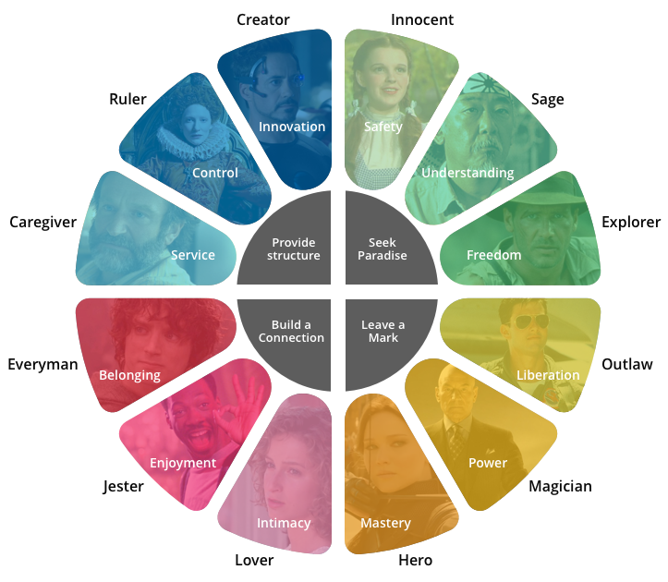
The Archetype Wheel
Webinar
Target Audience
Your nonprofit’s brand has a personality, which will determine how people connect with you and whether or not they want to get engaged with you, reply to your calls or support you. Your archetype determines you position, message and even visuals.
Your brand may combine up to three archetypes, but there is always the primary one.
Image source: https://mapandfire.com/

Slide 15
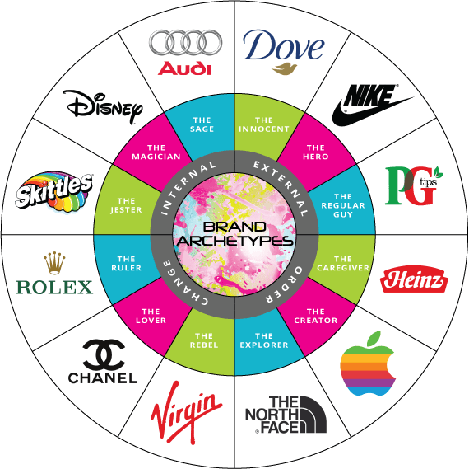
Brands and Archetypes
Webinar
Target Audience
Each archetype is characterised with:
Core desire
Goal
Strategy
Key Attributes
Greatest Fear
Explore the archetypes (e.g., here https://bit.ly/2D4uMlL) or take a quizz to define your nonprofit’s archetype (https://bit.ly/2U3Yflm)
Spoiler: most nonprofits belong to 3 archetypes – ‘Innocent’ (Red Cross), ‘Caregiver’ (World Wide Fund) or ‘Sage’ (Harvard).
Source: https://visionone.co.uk/

Slide 16
What do you with it?
Webinar
Target Audience
Step 1
Understand The Real Desire of Your Audience
Understand your customers WHY, and align everything you communicate as a brand with that WHY at the core
Step 2
Identify Your Personality Position
Match your customer’s desire to the archetype that best evokes that desire
Step 3
Adopt The Right Archetypal Mix
Your core archetype will represent a minimum of 70% of your overall brand personality, leaving 30% for differentiation.
Step 4
Give Your Brand Opinions and an Outlook on Life
With your archetypal mix (i.e. your audience) in mind, answer a set of questions in the way your audience would answer them
Some questions for Step 4
What do you love and why?
What do you dislike / hate and why?
Where do you bring the most value to your audience?
What is the one thing you would change about your industry above all else, and why?
Why is your market a great space to be in?
What positives and negatives do you believe social media has brought about in our society?
What is the purpose of your existence?
What is important to you in the way you do business?
What does your audience need to be protected against?

Slide 17
Homework
Webinar
I know you have been waiting for this ☺

Slide 18
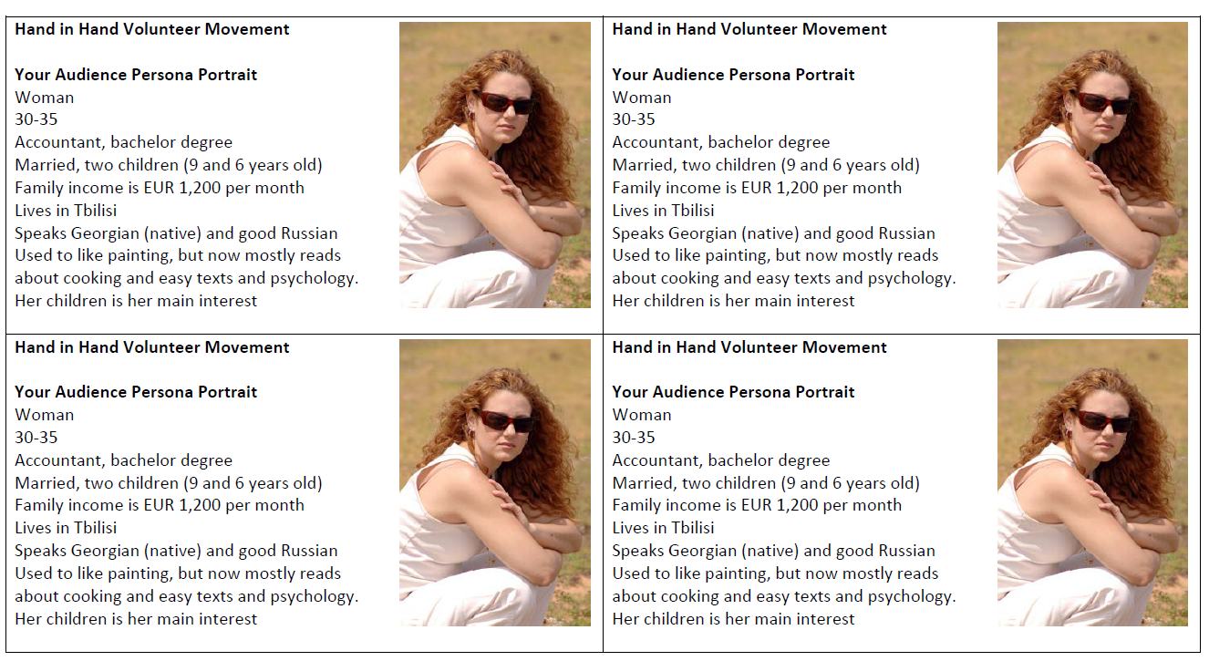
Your audience persona
Webinar
Homework
For Offline Seminar #2 you need to prepare, print out and bring with you a simplified version of your nonprofit’s audience person (just one).
Characteristics to describe + photo:
Gender
Age
Education and occupation (work or study)
Family status
Income
Where (s)he lives
Primary language and ethnicity (if relevant)
Identifiers, i.e. key interests / hobby
To make life easier, use the template.
Fill in one part and copy the content in other three parts (see here).

Slide 19




Thank you for your attention and see you soon!
Contacts
Project Regional Office:
23 Grigorenko Av., Suite 2505,
02000 Kyiv, Ukraine
+38 063 376 55 46
welcome@EaPCivilSociety.eu
www.EaPCivilSociety.eu
Trainer’s email: Iryna.Velska@EaPCivilSociety.eu
GDSI Office:
Block 15, Galway Technology Park
Parkmore, Galway, Ireland
+38 063 376 55 46
consulting@gdsi.ie
www.gdsi.ie
Oh, your questions are welcome ☺

