Slide 1
Media Landscape in Georgia
What You Need to Know Before Deciding on Media Platforms
April 18, 2019
Tbilisi, Georgia

Slide 2
Discussion question:
Training
Media landscape
What is media landscape?

Slide 3
Training
Media Landscape
Television
Facebook
Radio
YouTube
Online Media
Fragmented Audiences
Instagram

Slide 4
Television
Viewership
Who watches television?

Slide 5
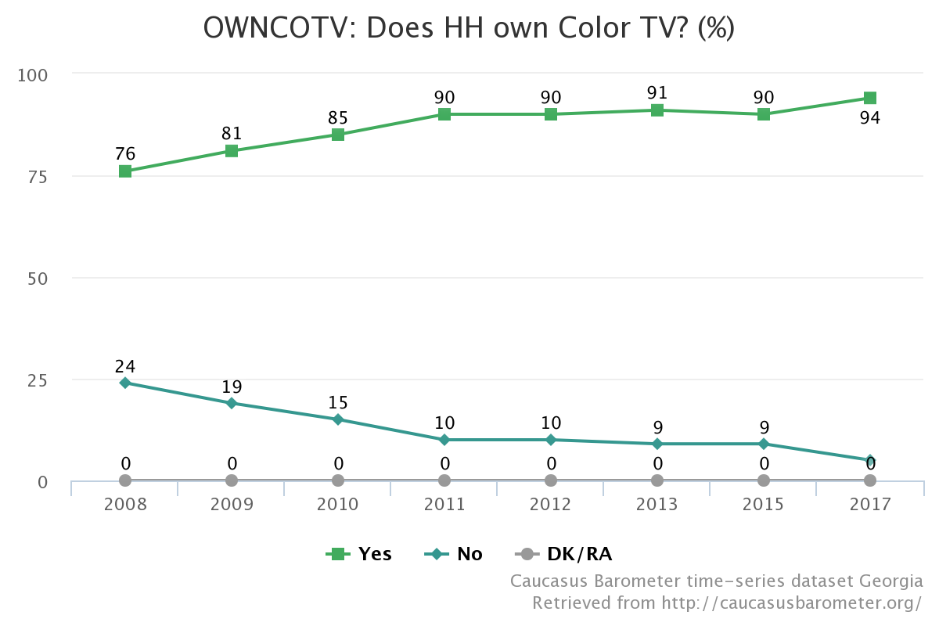
Households that Own Color TV (%)
Training
Media Landscape
Television
Television still remains an important source for information for many in the country and the reason could be the tradition remaining from the Soviet past, when Soviet TVs were popularized and sold for a cheap price to be affordable for everyone. Major source for propaganda was supposed to be in each household.

Slide 6
TV Average AMR% by Age
Training
Media Landscape
Source: TV MR GE

Slide 7
TV Average AMR% by Age
Training
Media Landscape
Source: TV MR GE

Slide 8
Radio
Listeners
What about radio?

Slide 9
Radio: mostly listened in transportation
Training
Media Landscape
Source: Innova, March 2018

Slide 10
Radio: times
Training
Media Landscape
Source: Innova, March 2018

Slide 11
Age categories
Training
Media Landscape
We don’t have the listening habits’ breakdown by age group, but since this research has about the same number of people for each age group, we can somewhat assume the equal distribution.
Source: Innova, March 2018

Slide 12
Internet
Users
How much of the Internet and why?

Slide 13
Use of computers
Training
Media Landscape
 | Urban | Rural
Daily | 87.1 | 68.8
Weekly | 8.8 | 19.4
Less than weekly | 4.1 | 11.7
 | 15-29 | 30-59 | 60+
Daily | 80.8 | 82.9 | 83.7
Weekly | 11.6 | 11.4 | 12.4
Less than weekly | 7.6 | 5.6 | 4.0
Source: GeoStat, July 2018

Slide 14
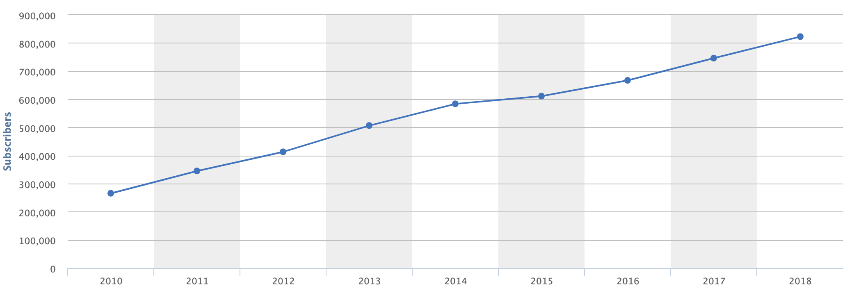
Internet Subscribers: 822,347
Training
Media Landscape
Source: GNCC analytical portal

Slide 15
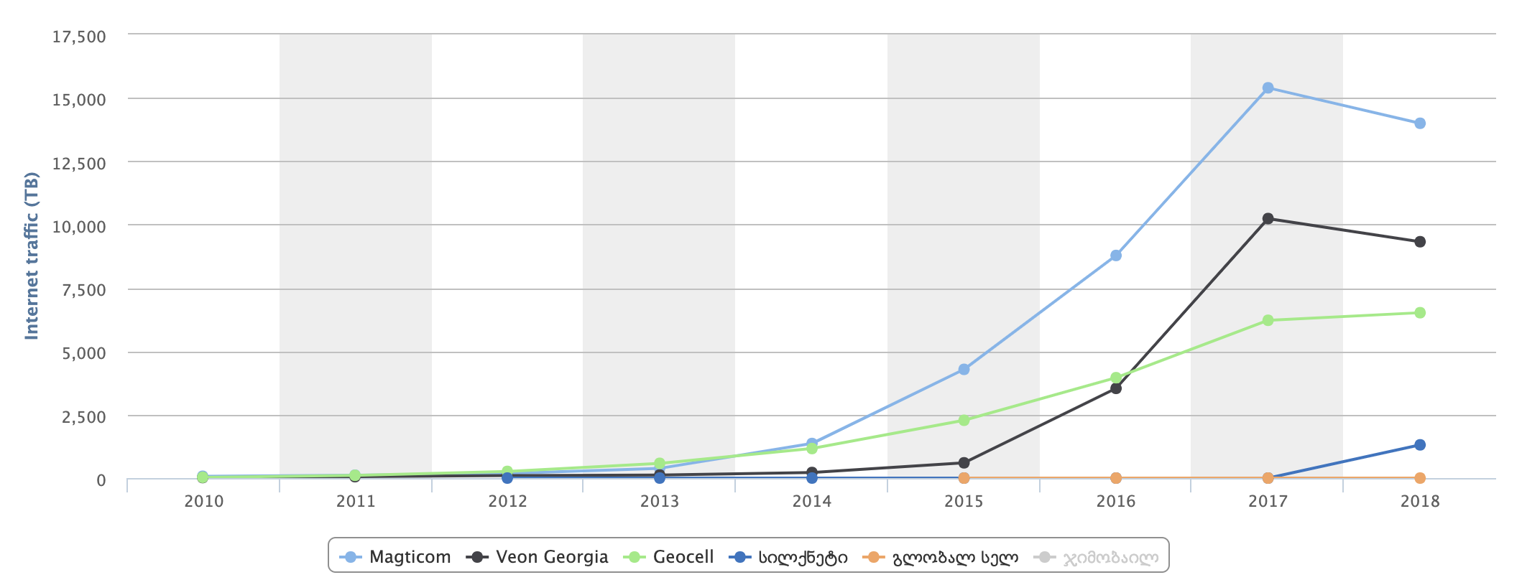
Mobile Internet Traffic (TB)
Training
Media Landscape
Source: GNCC analytical portal

Slide 16
Internet use
Training
Media Landscape
Source: GeoStat, July 2018

Slide 17
Internet use
Training
Media Landscape
Source: GeoStat, July 2018

Slide 18
Internet use by age
Training
Media Landscape
Source: TV MR GE

Slide 19
Internet used for: urban/rural
Training
Media Landscape
Source: GeoStat, 2018

Slide 20
Internet used for - age groups
Training
Media Landscape
Source: GeoStat, 2018

Slide 21
Social media
Social media uses
Where on social media?

Slide 22
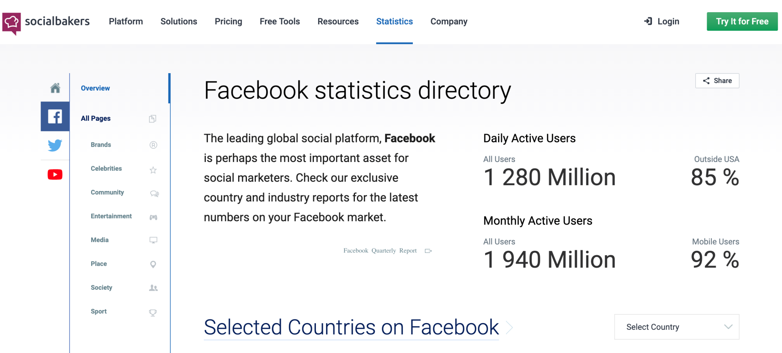
Socialbakers
Training
Media Landscape
Check for free statistics for:
Facebook
YouTube
Twitter
Search by country

Slide 23
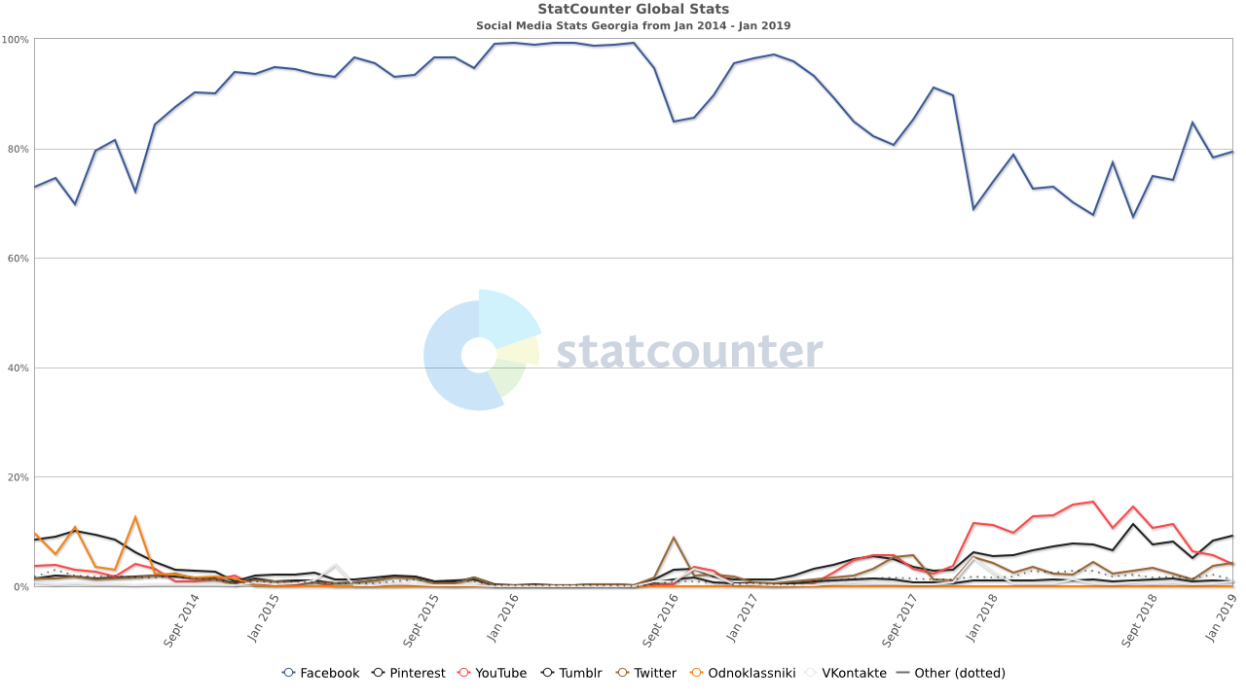
Social media in Georgia: market shares
Training
Media Landscape
Facebook: 83.73%
Pinterest: 9.37%
YouTube: 3.04%
Twitter: 1.68%
Instagram: 0.9%
Tumblr: 0.59%
VKontakte: 0.94%
Odnoklassniki: 0%
Source: http://gs.statcounter.com/social-media-stats/all/georgia/

Slide 24
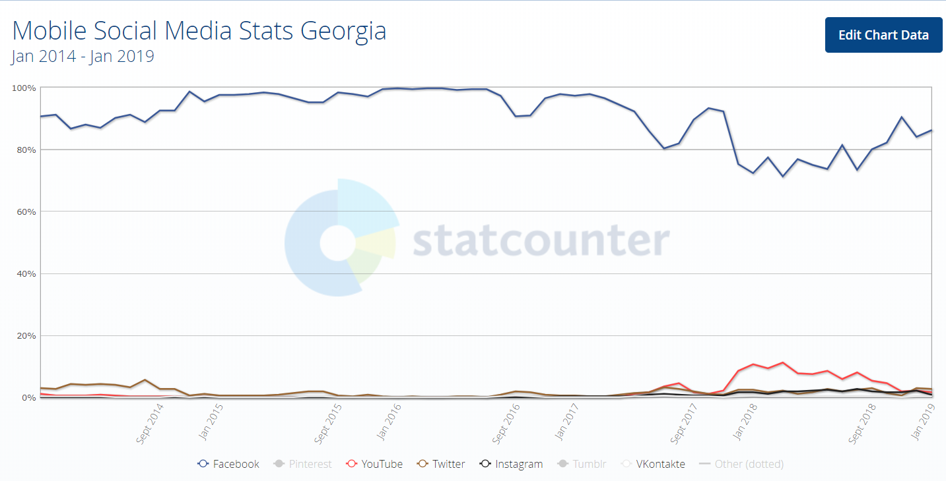
Social media in Georgia: mobile
Training
Media Landscape
Source: http://gs.statcounter.com/social-media-stats/all/georgia/

Slide 25
Facebook Insights
Training
Media Landscape
Create a Facebook page and keep an eye on:
Likes, Reach, Page views to see when your page attracts most of each.
Add pages to watch – those of your competitors and monitor how your page compares with them
Check out People to see who is following you and who are your audiences.

Slide 26
Regulations
What’s allowed
Where to look for answers?

Slide 27
Regulations to note
Training
Media Landscape
A person may protect in court his/her honor, dignity, privacy, personal inviolability or business reputation from defamation.
If information defaming the honor, dignity, business reputation or privacy of a person has been disseminated in the mass media, then it shall be retracted in the same media.
If such information is contained in a document issued by an organization, then this document shall be corrected and the parties concerned shall be informed of the correction.
A person whose honor and dignity has been defamed by information disseminated in the mass media may disseminate information in answer to the defamation through the same media.
Source: Article 18, Civil Code of Georgia

Slide 28
Training
Media Landscape
Regulations to note
Same regulations apply also when a person’s image (photograph, film, video, etc.) has been disseminated without his/her consent.
The consent of the person shall not be required when photo-taking (video recording, etc.) is connected with his/her public recognition, the office he/she holds, the requirements of justice or law enforcement, scientific, educational or cultural purposes, or when the photo-taking (video recording, etc.) has occurred in public circumstances, or when the person has received compensation for posing.
Source: Article 18, Civil Code of Georgia

Slide 29
Training
Media Landscape
Regulations to note
Call for violence and hate speech can only be punished if it meets the test of clear, imminent and present danger.
Copyright law does not differentiate between traditional and social media or online content; always pay attention to copyright owners, since you can re-publish something ONLY if the material carries importance in the political, social, or religious context, without asking for permission and simply indicating the source, otherwise there is a chance that the content is someone’s intellectual property.

Slide 30
Recommendations
Training
Media Landscape
Know your audiences and what you want from them
Have a strategy for each platform, with benchmarks
For wider reach go on primetime TV show
Maintain a website for linking from Social Media
Always experiment, then analyze, then decide
Invest in communication strategy, it will pay off

Slide 31
Thank you for your attention!
Contacts
Project Regional Office:
23 Grigorenko Av., Suite 2505, 02000 Kyiv, Ukraine
+38 063 376 55 46
welcome@EaPCivilSociety.eu
www.EaPCivilSociety.eu
GDSI Office:
Block 15, Galway Technology Park Parkmore, Galway, Ireland
+38 063 376 55 46
consulting@gdsi.ie
www.gdsi.ie
Trainer: a.keshelashvili@gipa.ge

