Slide 1
Visual Communications:
Images and Infographics
Module #2: IT for Efficient Communications
‘Digital Competences for CSOs and Activists’ Course
April 2019
Tbilisi (Georgia) / Kyiv (Ukraine) / Minsk (Belarus)

Slide 2
Why do you need visuals?
Offline Seminar #2
Visual Communications
94%
64%
Content with compelling images experience
According to Social Science Research Network,
more views on average
than content without images
of people
are visual learners
Visual materials include photos, animations, graphics and video.
Visuals are processed 60,000 times faster than text, which means you can paint a picture for your audience much faster with an actual picture.
Most people remember only 20% of what they read. 90% of information transmitted to the brain is visual.
Source: https://www.fastcompany.com/

Slide 3
10 ways nonprofits can use visuals
Offline Seminar #2
Visual Communications
01
02
03
Release data with an infographic
Enhance storytelling
Highlight quotes and facts
Infographics make a way to visualize data in a shareable format
Images create an emotional connection to characters and your cause
Overlay a great quote on a picture or couple a powerful fact with a graphic
04
05
Create a collection
Show your funny side with memes
Participants love viewing and sharing albums
Be risky – memes are great visuals and very shareable

Slide 4
10 ways nonprofits can use visuals (2)
Offline Seminar #2
Visual Communications
06
07
08
Document events
Show behind-the-scenes activities
Make your website shine
Newsletters, news posts, reporting, advocacy, promotion of future events...
It will show your supporters you are people just like working on a great cause
Change all blurry, low-resolution images on your website. Today!
09
10
Organize and direct
Spread the love
Add adding visual cues (icon) to your communications to improve readability
Ask your personnel and supporters to use your cover photo for their profiles
Source: https://www.networkforgood.com/
Source: https://www.networkforgood.com/

Slide 5
Images
Offline Seminar #2
Let’s go!

Slide 6
Good practices and more
Offline Seminar #2
Visual Communications
Images MUST
be of high quality, with copyright clearance and meaningful. It goes without saying.
Show the impact of your work: If you help people, show the people you're helping. If you clean up a park, take “before and after” pictures.
Choose natural or unposed images, rather than showing a group of people smiling at the camera.
For event photos, avoid “person with a microphone” images.
Reconsider stock images:
  Websites look less professional with pictures or photos in different styles.
  Stock photos look generic, you are loosing connection.
  Your competitors could use the same images.
Free and unusual collections:
  Unsplash.Com: 850,000+ photos
  Pixabay.Com/: photos, vectors, videos
  Pexels.Com/: no attribution is required
  Flickr.com/: always check the license!
Mostly vectors: Vexels.com/, Freepik.com/ and Freevector.com/

Slide 7


Images and archetypes: Innocent
Offline Seminar #2
Visual Communications
Famous brand: Red Cross
Goal: To be happy
Strategy: To do things right
Images that work for you the best: People turn to you for inspiration, so demonstrate your playful character and optimistic side with bright, sunny images; let people remember you as a positive brand / organisation / group.
Source: blog.depositphotos.com/

Slide 8
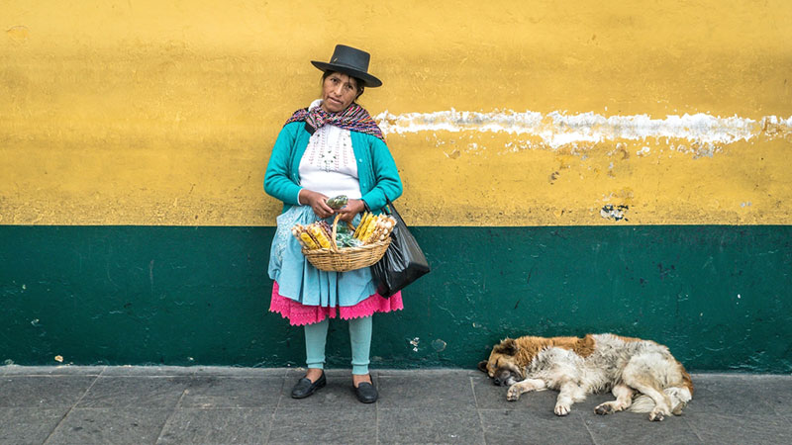

Images and archetypes: Caregiver
Offline Seminar #2
Visual Communications
Famous brand: Unicef
Goal: To help and care for others
Strategy: Protecting and doing things for others
Images that work for you the best: Images focusing on people and connections between them work the best for you, as well as images on issues important for your brand, like ecology or social issues.
Source: blog.depositphotos.com/

Slide 9


Images and archetypes: Sage
Offline Seminar #2
Visual Communications
Famous brand: Smithsonian
Goal: To use intelligence and wisdom to understand the world
Strategy: Seek out information and knowledge
Images that work for you the best: This archetype likes adventures and often publishes photos of nature to stress his cognitive need and desire to learn the world. This archetype is fine with posting photos to make one think, or photos of intellectual talking.
Source: blog.depositphotos.com/

Slide 10
Enhancing Your Photos:
Cropping
Offline Seminar #2
Sweet and simple

Slide 11
Three basic rules…
Offline Seminar #2
Visual Communications
Strong photo cropping and extreme formats are always in
… to make any photo better:
Refuse standard formats (unless you prepare them for a gallery / album)
Acknowledge and use dynamics in a photo.
Build contrasts by moving the visual centre.

Slide 12
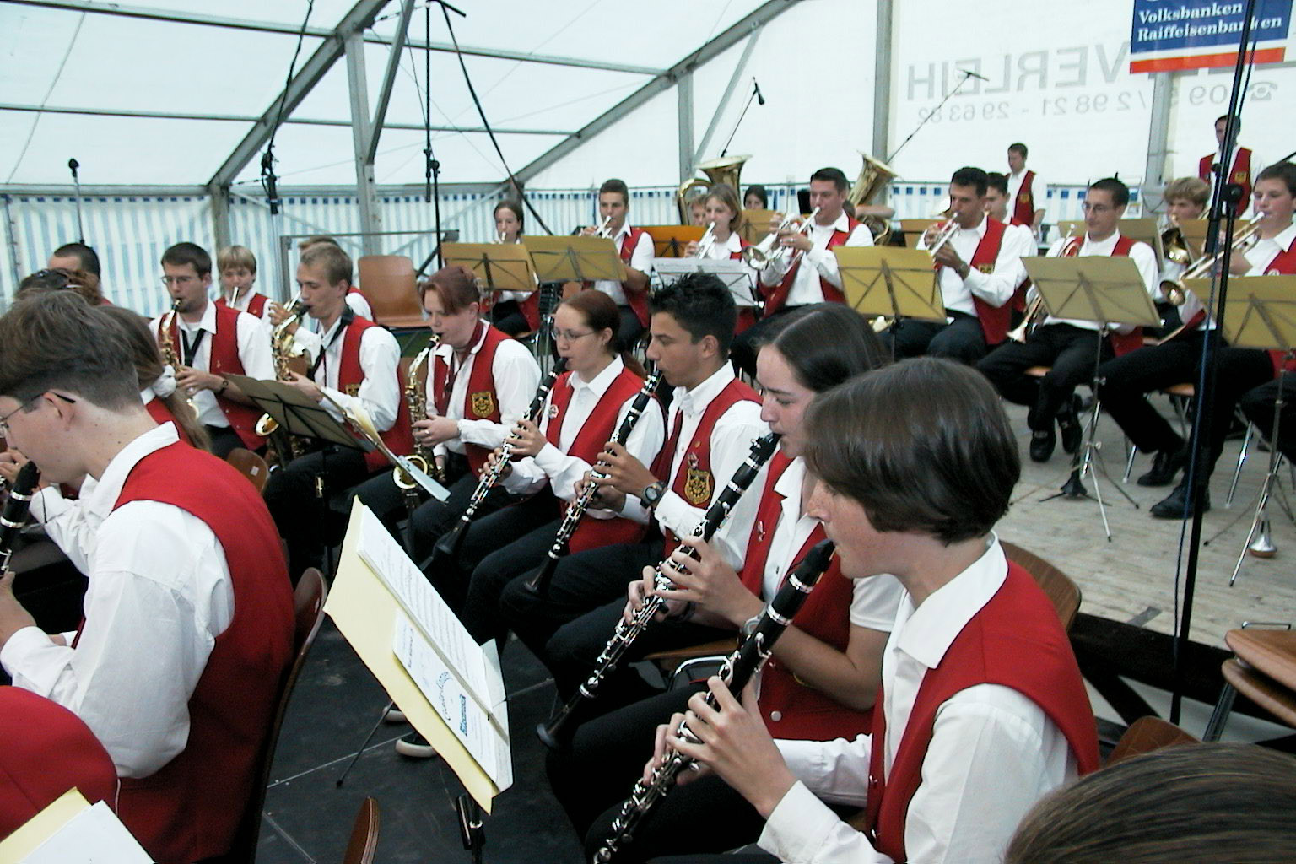
Photo cropping: example #1
Offline Seminar #2
Visual Communications
Before

Slide 13
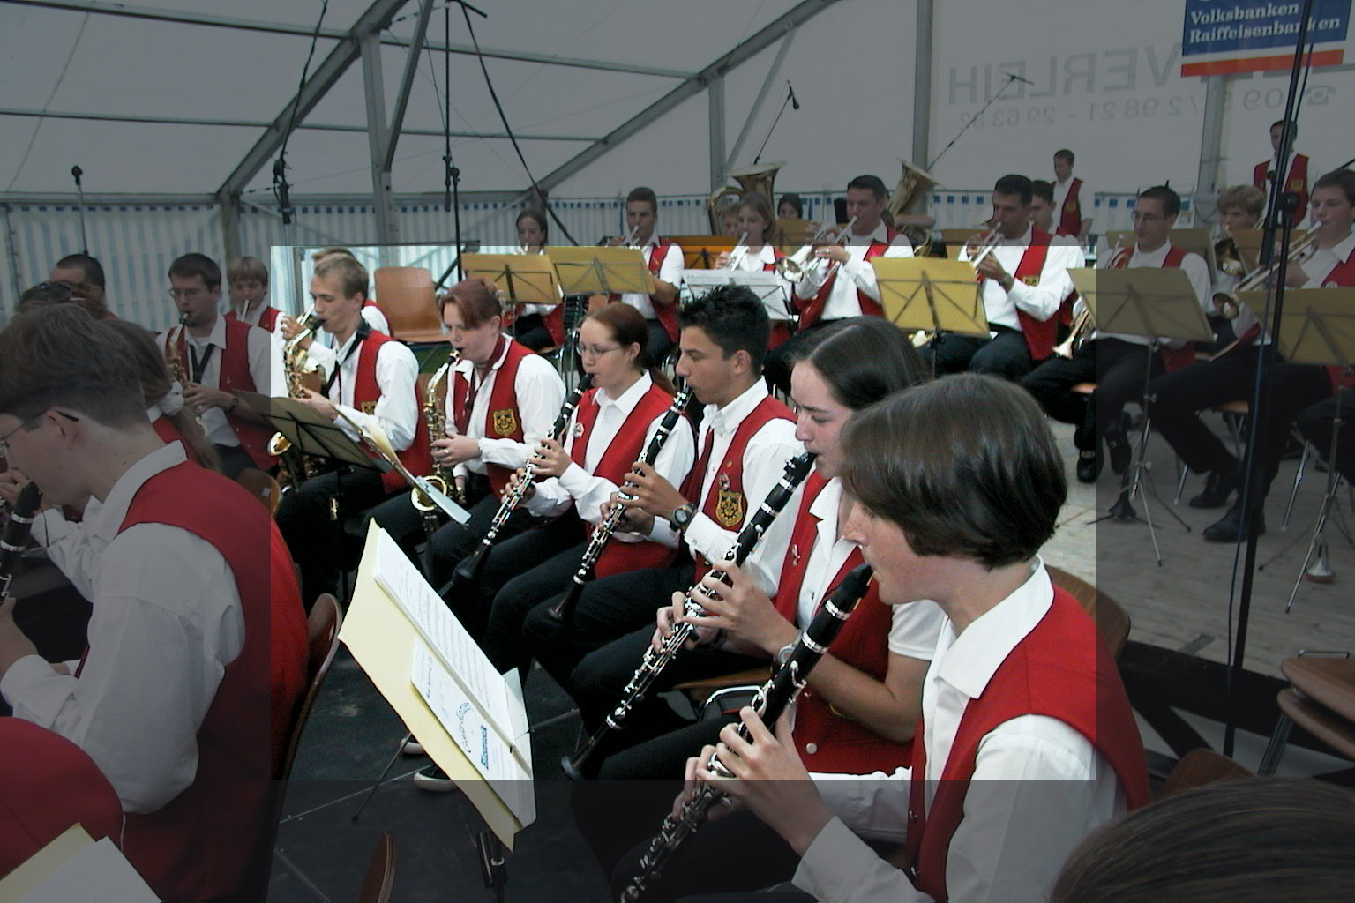
Photo cropping: example #1
Offline Seminar #2
Visual Communications
After

Slide 14
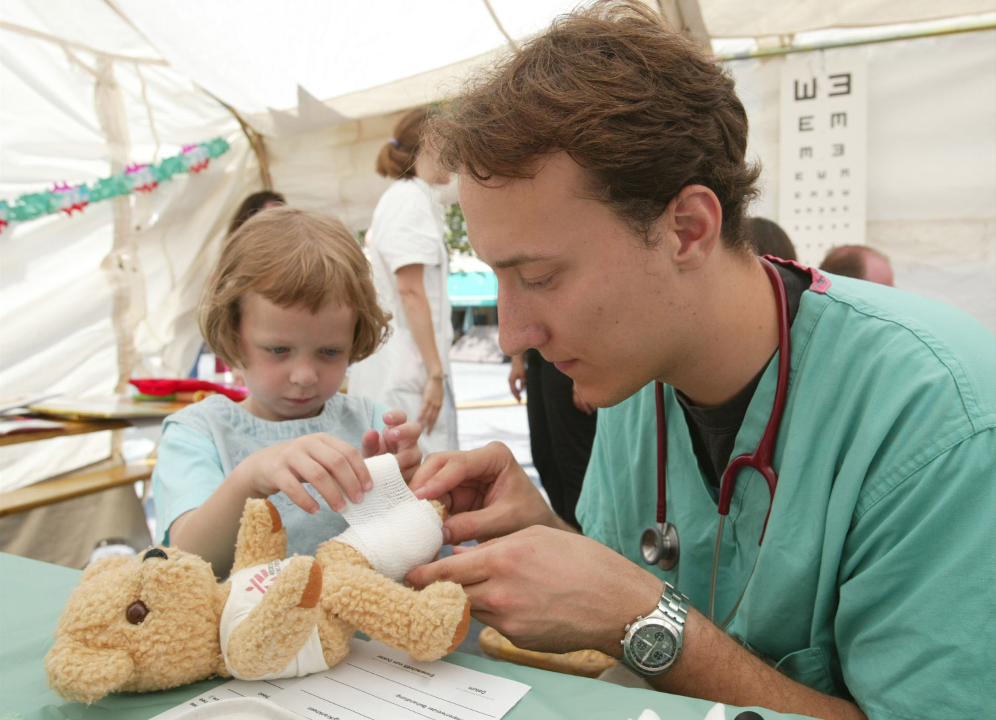
Photo cropping: example #2
Offline Seminar #2
Visual Communications
Before

Slide 15
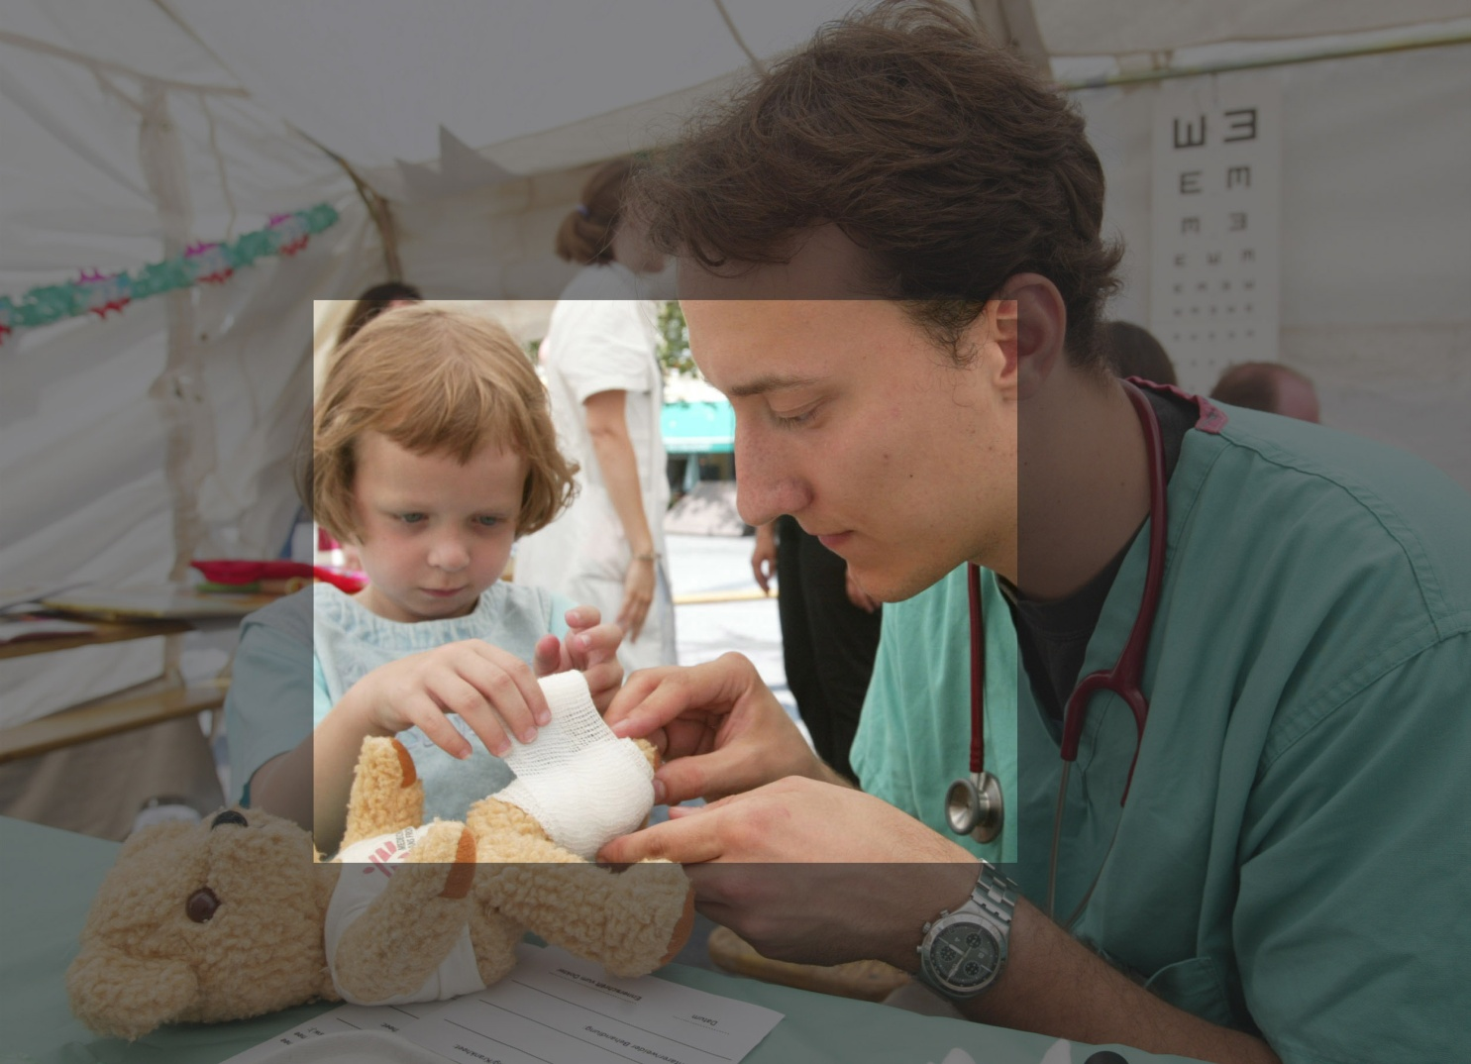
Photo cropping: example #2
Offline Seminar #2
Visual Communications
After

Slide 16
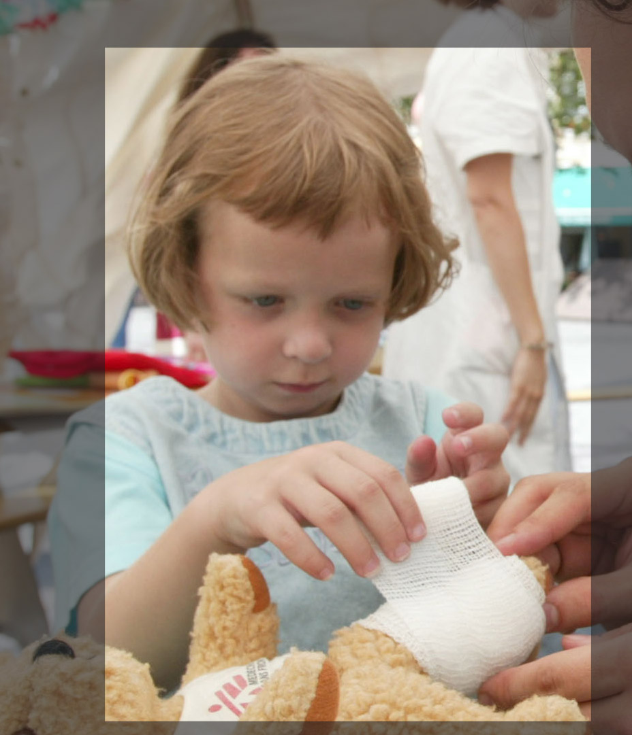
Photo cropping: example #2
Offline Seminar #2
Visual Communications
After

Slide 17
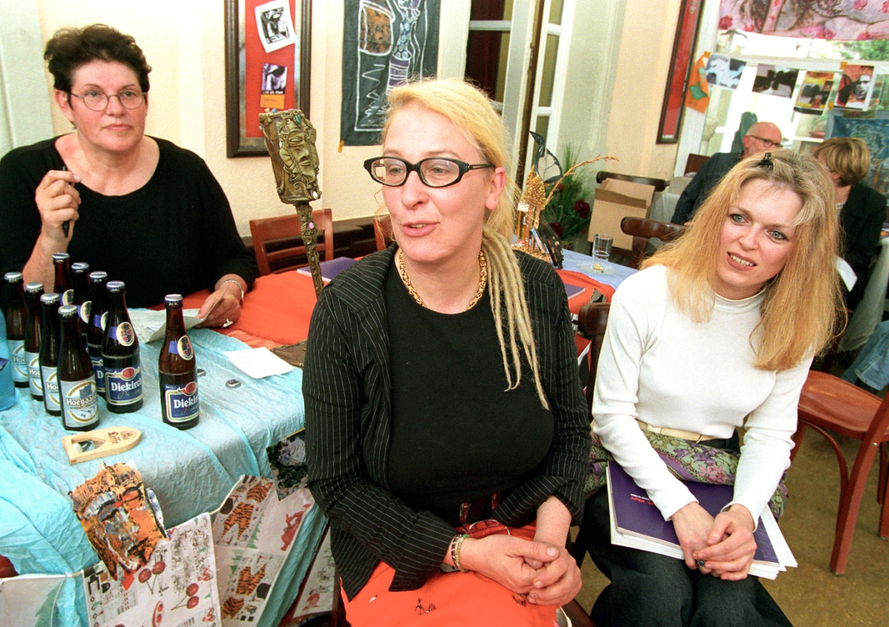
Photo cropping: example #3
Offline Seminar #2
Visual Communications
Before

Slide 18
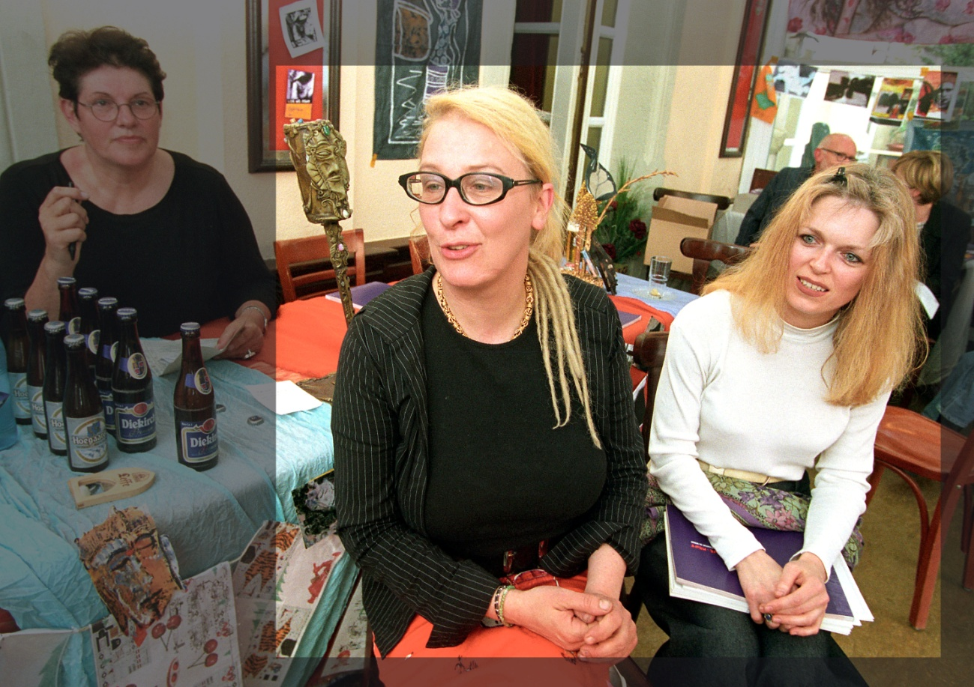
Photo cropping: example #3
Offline Seminar #2
Visual Communications
After

Slide 19
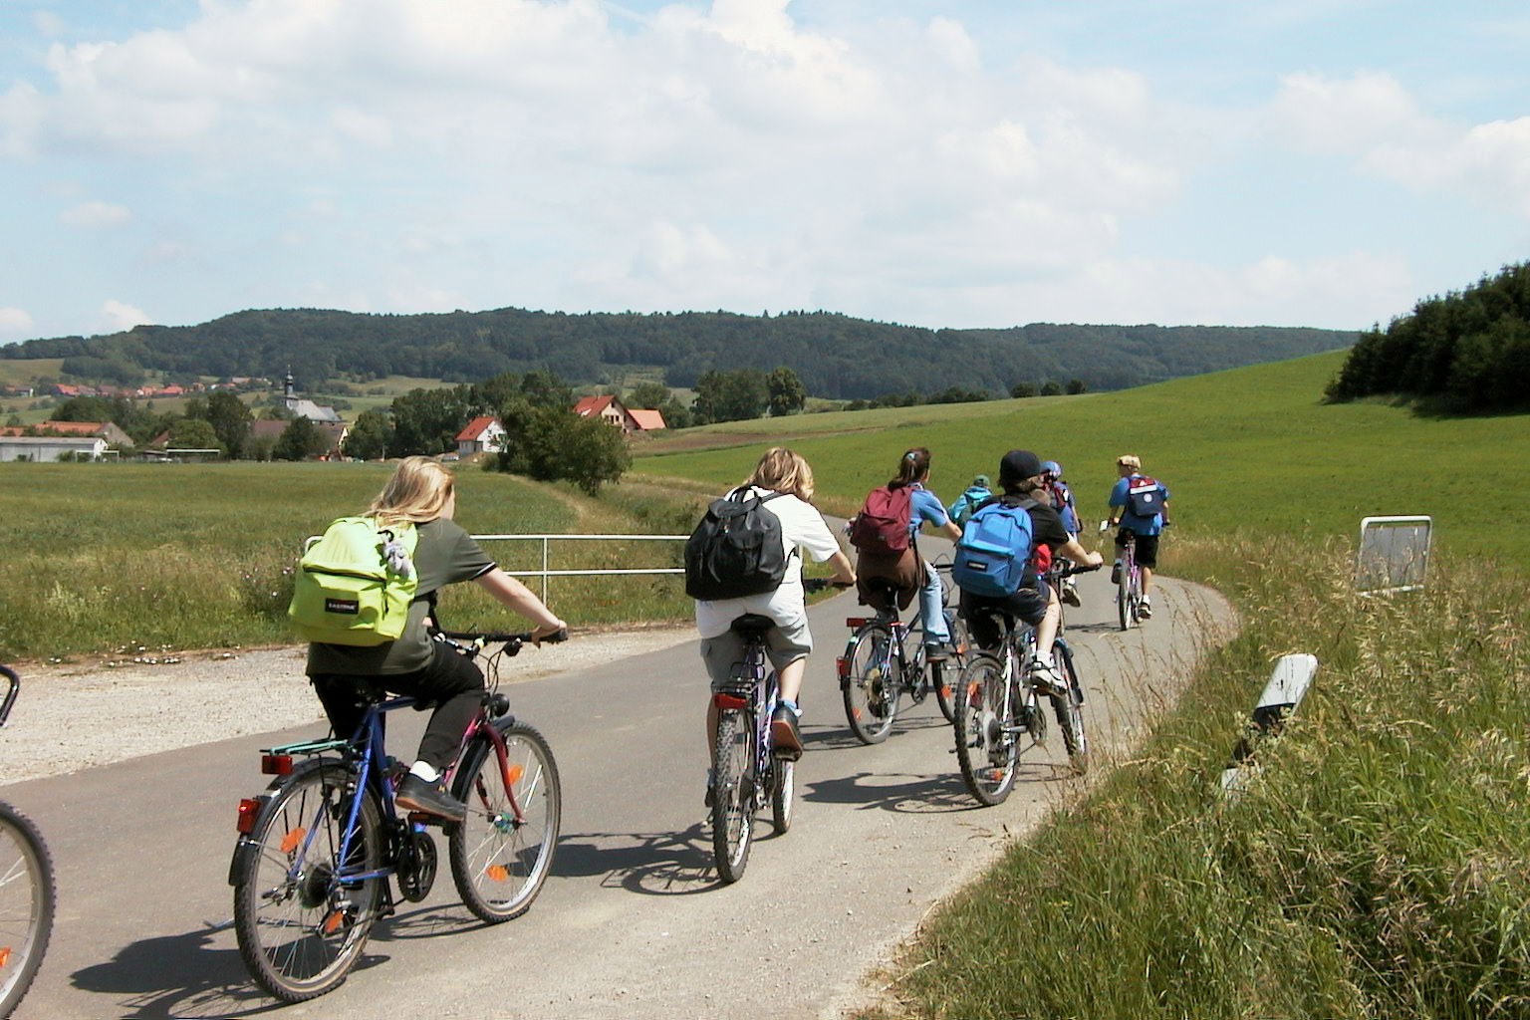
Photo cropping: example #4
Offline Seminar #2
Visual Communications
Before

Slide 20
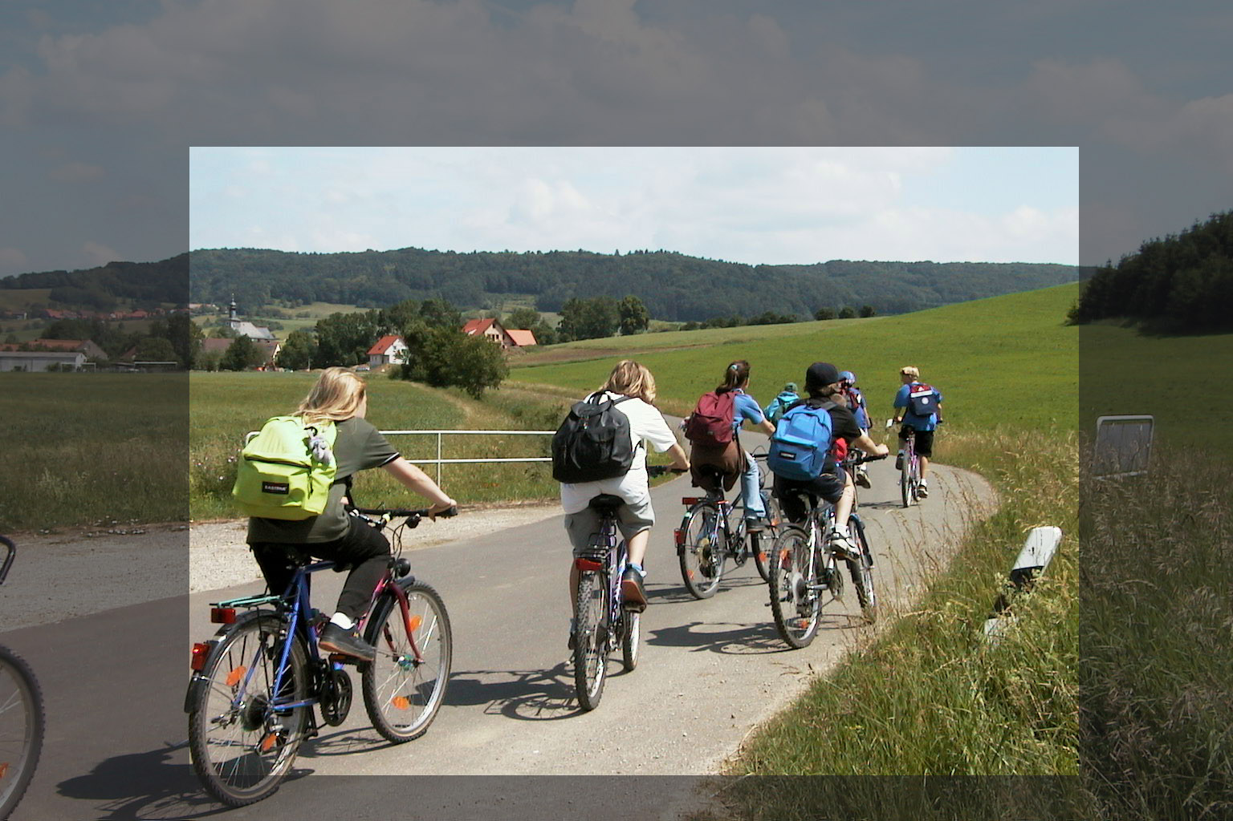
Photo cropping: example #4
Offline Seminar #2
Visual Communications
After

Slide 21
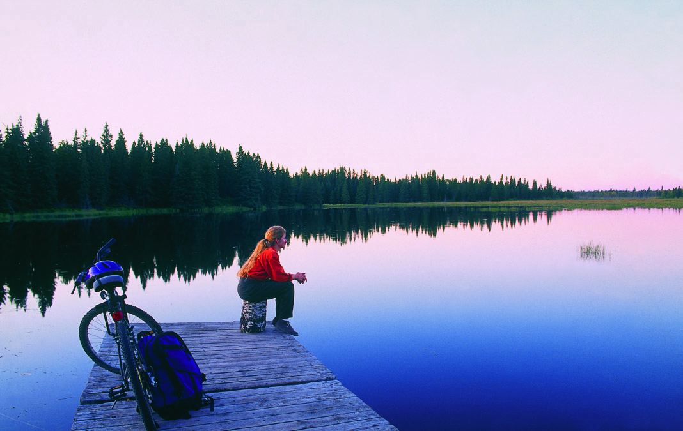
Photo cropping: example #5
Offline Seminar #2
Visual Communications
Before

Slide 22
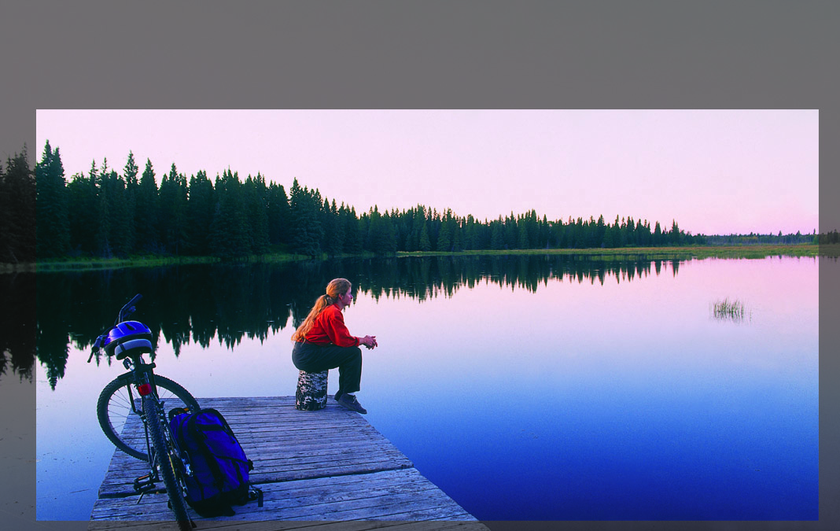
Photo cropping: example #4
Offline Seminar #2
Visual Communications
After

Slide 23
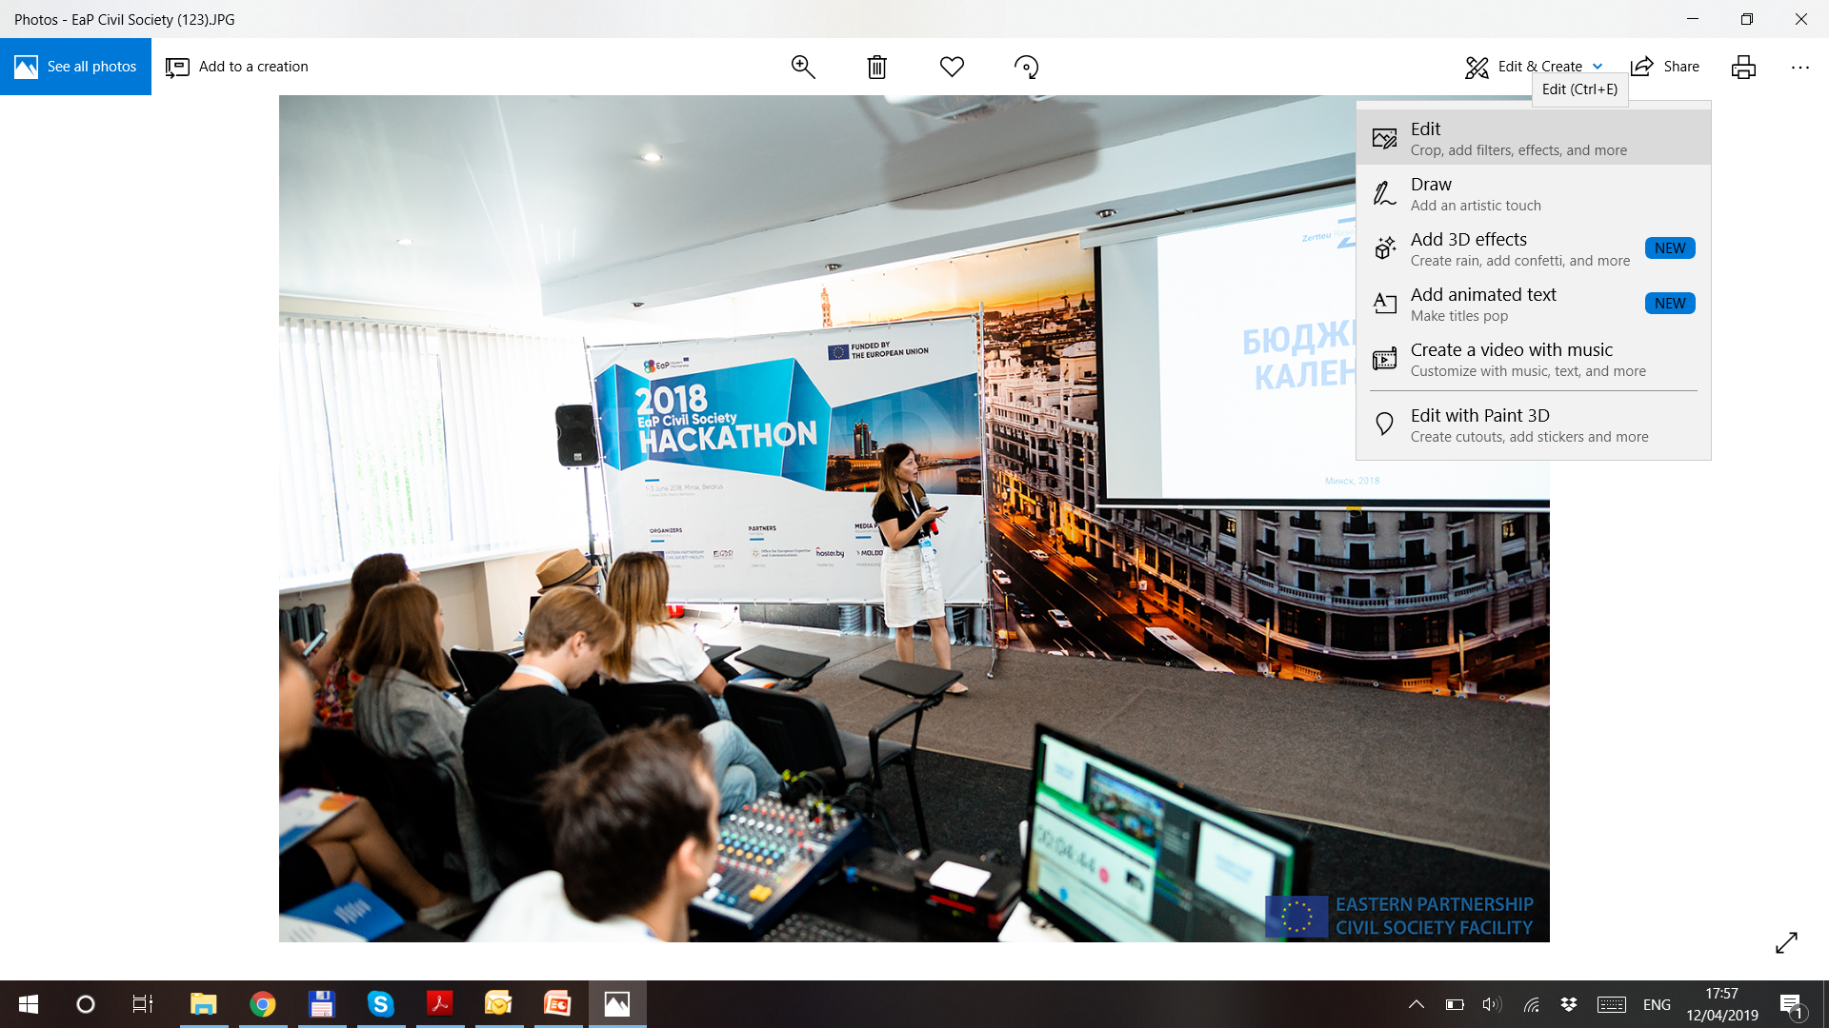
How to: Step 1 (choose the photo)
Offline Seminar #2
Visual Communications

Slide 24
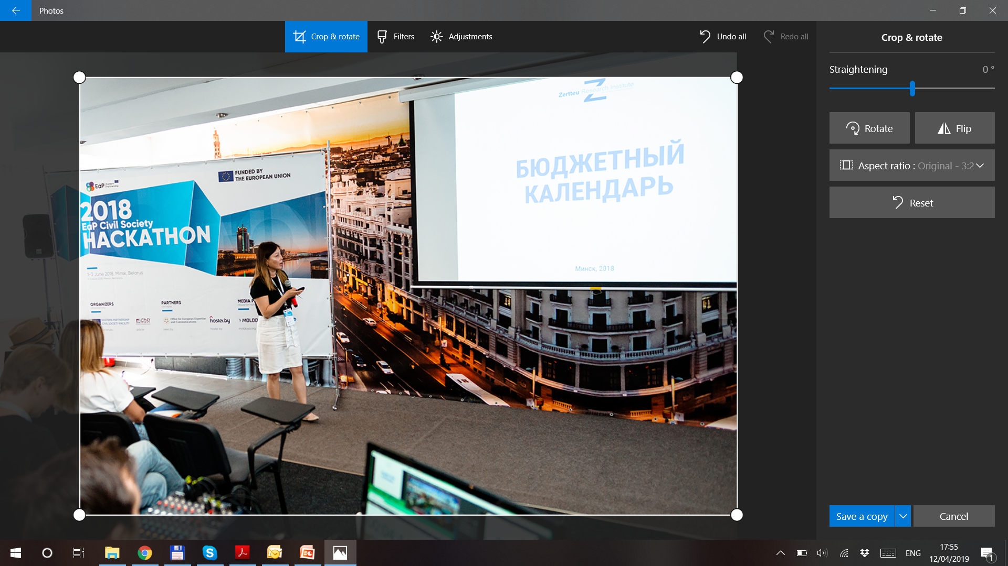
How to: Step 2 (select ‘original ratio’)
Offline Seminar #2
Visual Communications

Slide 25
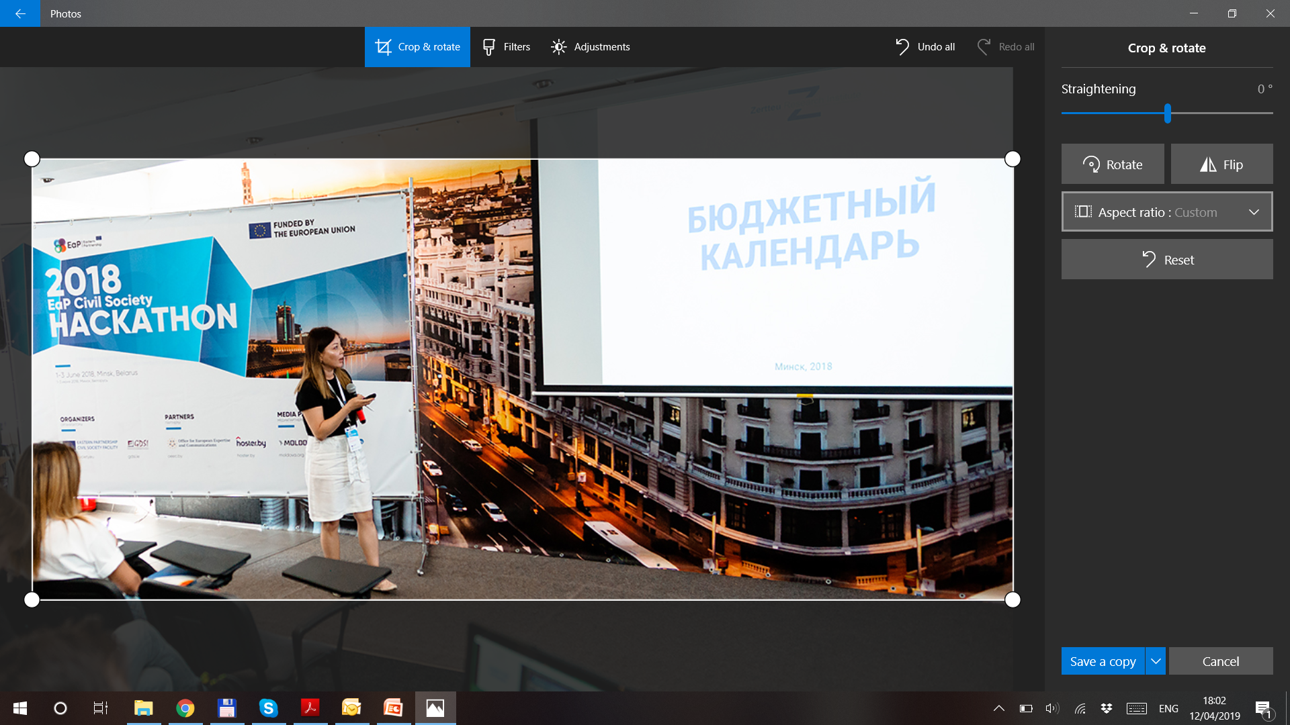
How to: Step 2 (or select ‘custom ratio’)
Offline Seminar #2
Visual Communications

Slide 26
How to: Step 3 (use ‘save as’ / ‘save a copy’ option)
Offline Seminar #2
Visual Communications
Your turn!
Select 2-3 photos you want to enhance
Open them with any application you have installed
Call me if you need help or advice
Let’s aim to have 2 photos done in 10 minutes
P.S.: It’s ok to work in small groups of 2-3 people or individually

Slide 27
Infographic simplified
Offline Seminar #2
Just some basic things

Slide 28

Infographic in easy terms
Offline Seminar #2
Visual Communications
Infographics are graphics that use visual elements to present information.
They are often used to visualize data, step-by-step processes, timelines, research findings, organizational hierarchies, and many other types of information.
Reasons for popularity: Simplify complex information
Condense long texts into one page
Engage audiences
Enhance boring documents with illustrative visuals
Infor-
mation
Graphic
Info-
graphic

Slide 29
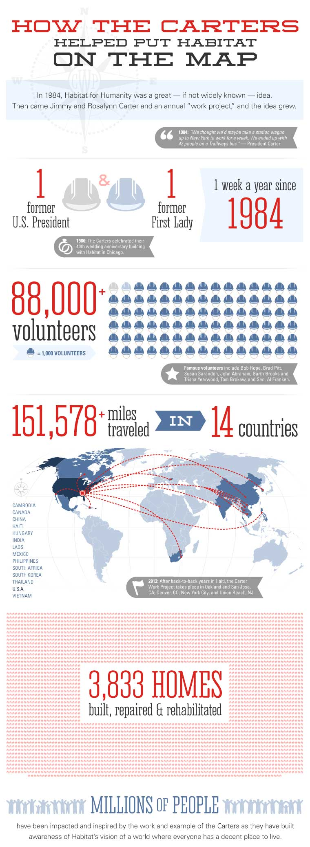
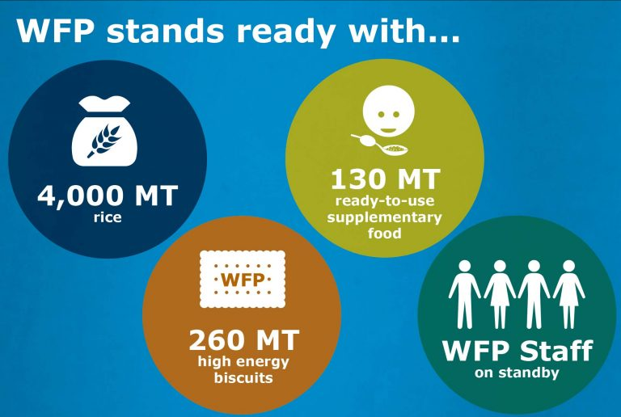
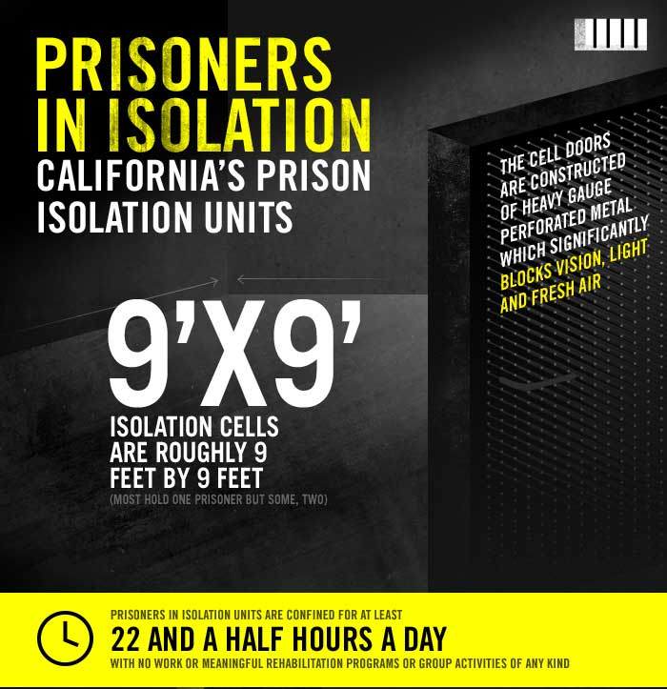

What do we call an infographic? – Everything!
Offline Seminar #2
Visual Communications
For inspiration (English only):
https://bit.ly/2XdG2UH

Slide 30
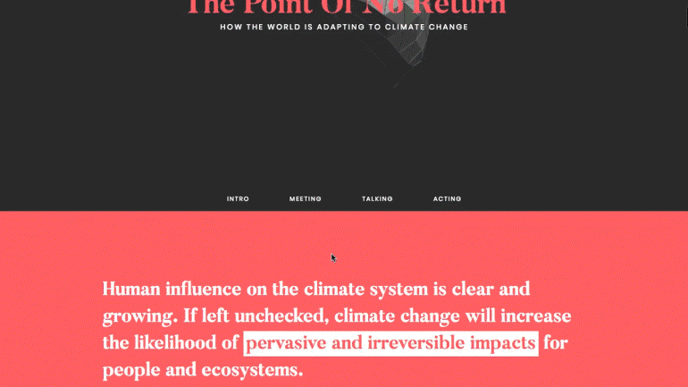
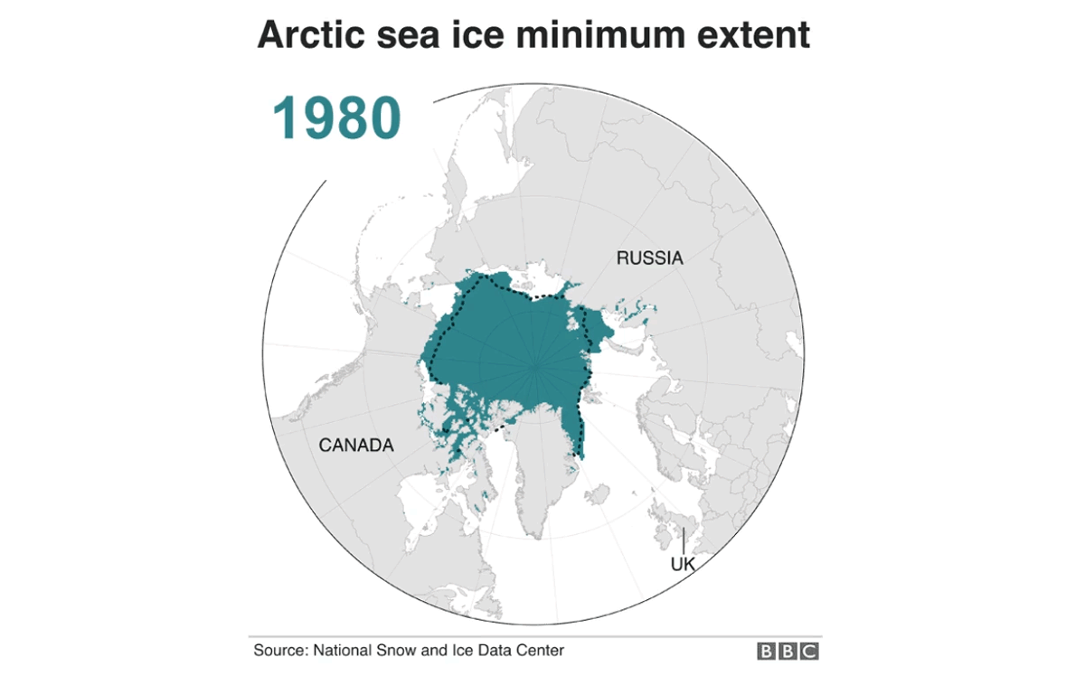
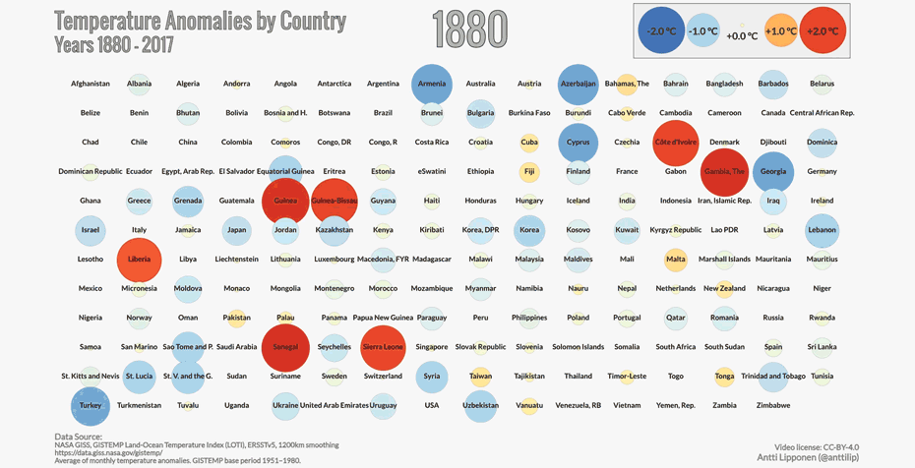
And everything like this…
Offline Seminar #2
Visual Communications
For inspiration (English only):
https://bit.ly/2RWeftB

Slide 31
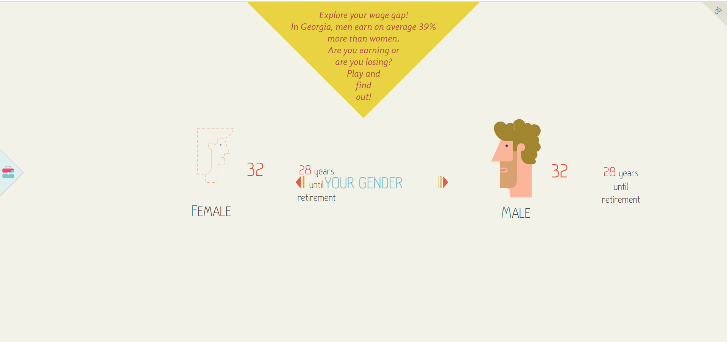
And even this!
Offline Seminar #2
Visual Communications
Check out the best information graphics in the world, according to the Society of News Design: https://www.snd.org/bodd/
This is my personal inspiration resource #1.
Another great collection: https://bit.ly/2UePZiD
http://tanastsoroba.ge/en/game

Slide 32
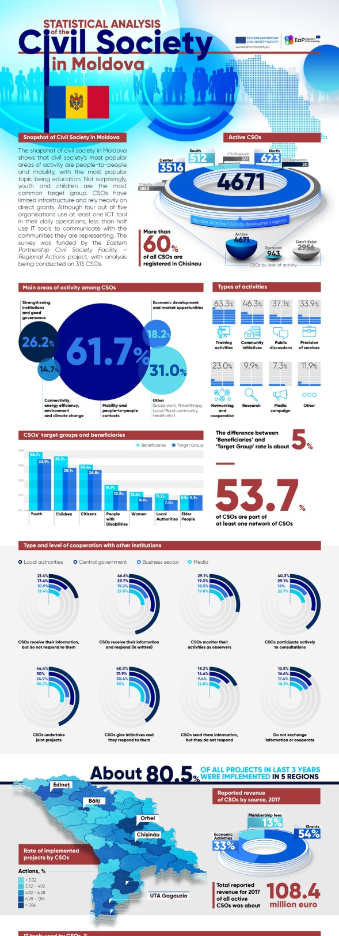
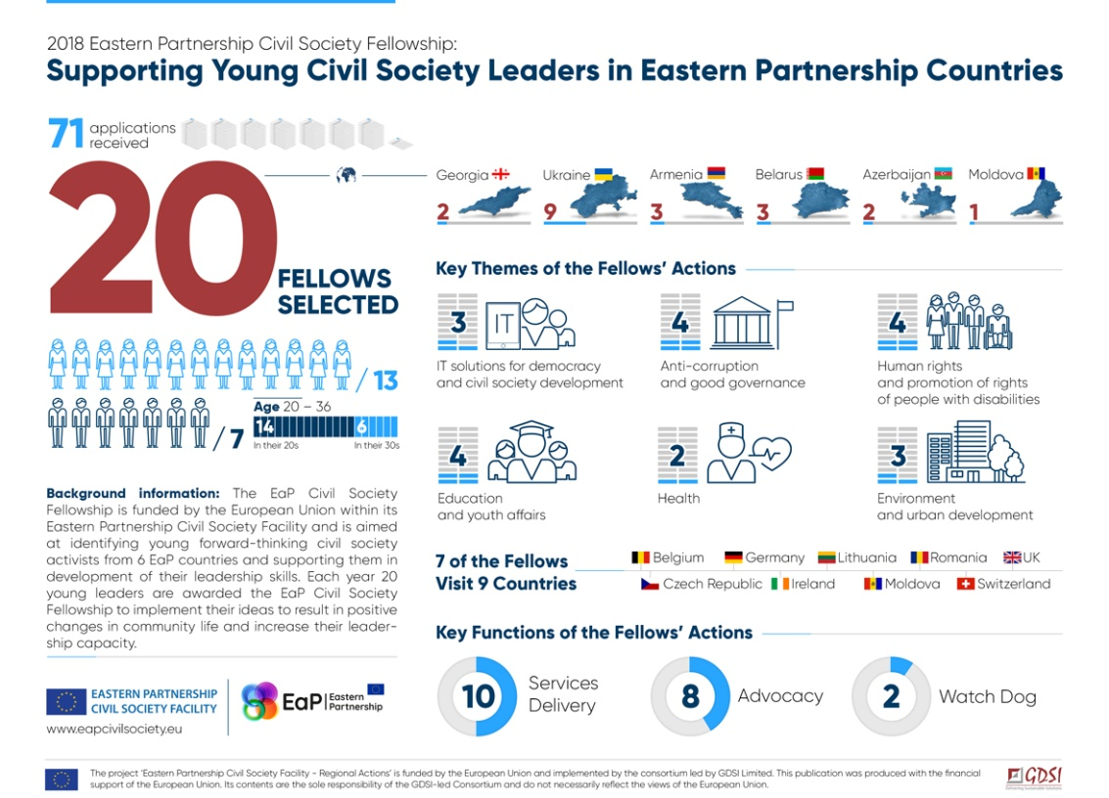

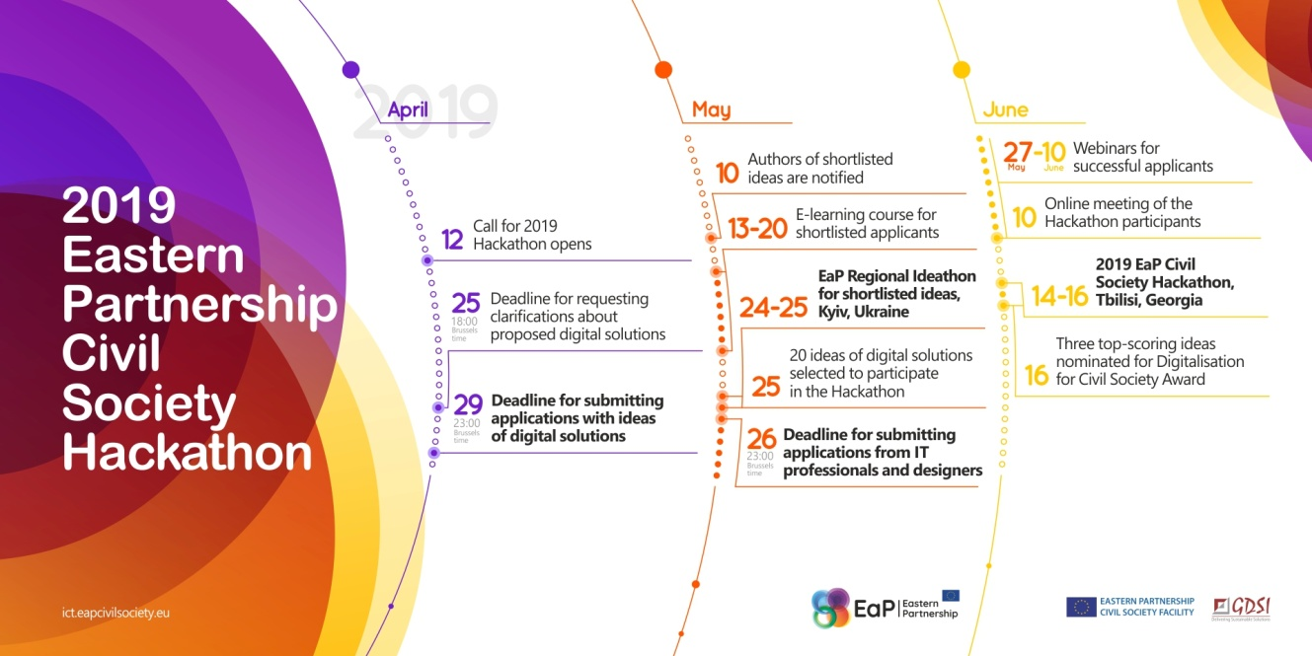
How our Project uses infographics
Offline Seminar #2
Visual Communications

Slide 33
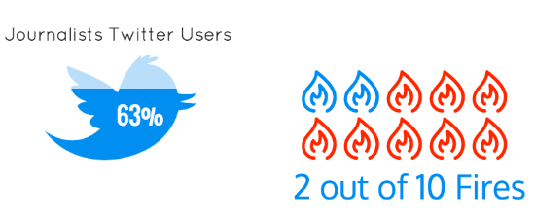
Choosing the right type: Inform
Offline Seminar #2
Visual Communications
Your goal: to convey an important message or data point.
What works the best: data visualizations that combine large titles, labels, and pictograms.
Source:
https://venngage.com/blog/create-infographics

Slide 34
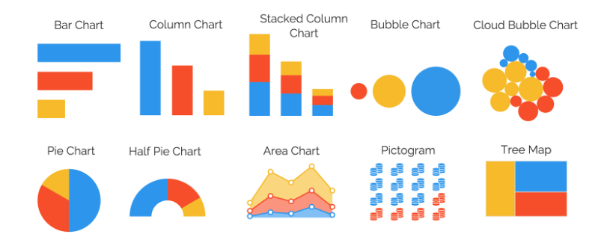
Choosing the right type: Compare
Offline Seminar #2
Visual Communications
Your goal: to compare multiple things or parts of whole.
What works the best: bar charts, pie charts, pictograms, and other chart that allow you to show data points side by side.
Source:
https://venngage.com/blog/create-infographics

Slide 35
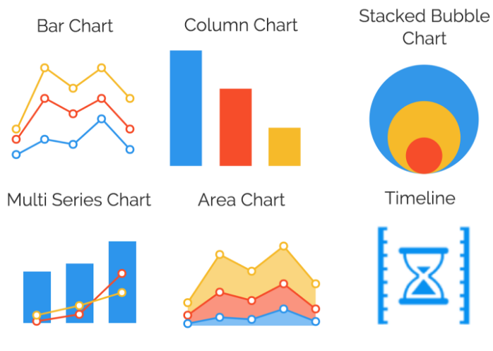
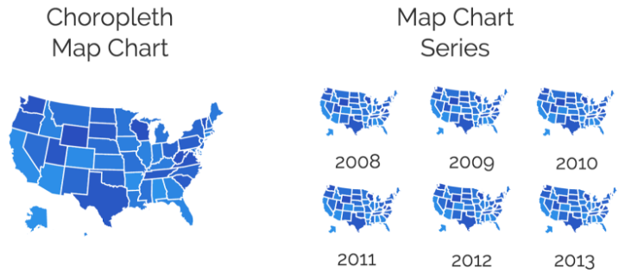
Choosing the right type: Change
Offline Seminar #2
Visual Communications
Your goal: to show changes or trends over time and space.
What works the best: line charts, bubble charts, timelines and multi series charts allow you to visualize upward or downward trends.
If you want to visualize spatial changes or trends, a choropleth map chart works well. Choropleth map charts use shading/coloring to indicate average values of properties or quantities within defined areas.
A map chart series can effectively illustrate something like a population change over time.
Source:
https://venngage.com/blog/create-infographics

Slide 36
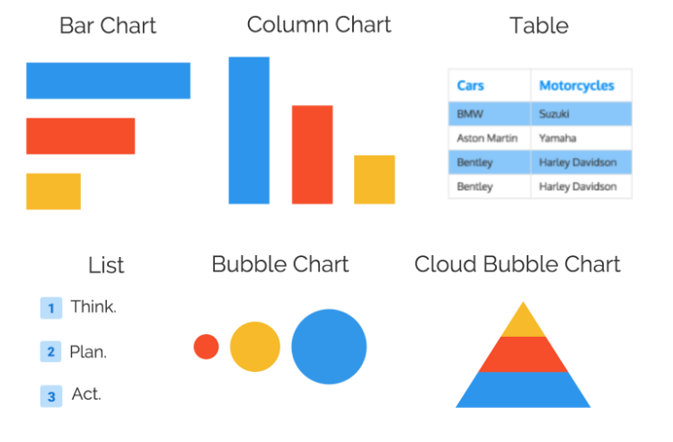
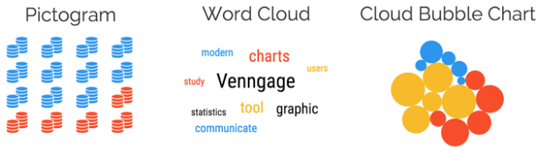
Choosing the right type: Organise
Offline Seminar #2
Visual Communications
Your goal: to show groups, patterns, ranks or order.
What works the best: lists, tables, and pyramid charts are ideal to rank or organise data. Bar charts and bubble charts can also be used to rank information.
For organized groups, use charts that allow you to group data like bubble clouds, word clouds, and icon charts.
Source:
https://venngage.com/blog/create-infographics

Slide 37
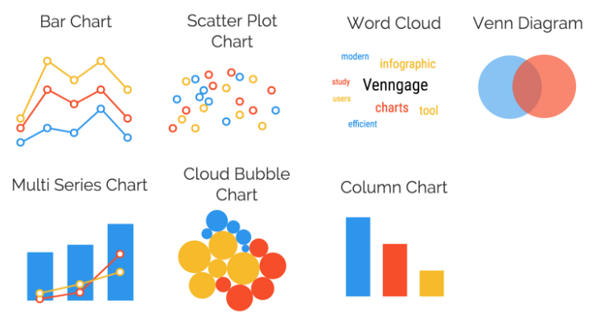
Choosing the right type: Relationships
Offline Seminar #2
Visual Communications
Your goal: to reveal relationships between things.
What works the best: charts that allow you to connect and compare points.
Source:
https://venngage.com/blog/create-infographics

Slide 38
5 steps to create an amazing infographic
Offline Seminar #2
Visual Communications
01
Come with an idea
It must be simple and well known to you, so at the end you have a holistic, logical, simple, visually clear and attractive product
02
Prepare data
The Do’s of good infographic design:
Include a big, eye-catching title card
Use visuals cues to guide readers (icons, lines, arrows, etc.)
Align your design elements – left, right or centre
The Don’ts of any infographic design:
Use more than two columns (busy and difficult to read)
Cram everything together (difficult to read)
Overload your sources sections (it’s not a PhD thesis)
… and come up with the best way to present it: timeline, scheme, map with explanations, chart, comparison,..
03
Simplify!
You main goal shall be to transfer some key information quickly to your reader. Do not overload it with data
04
Decide on visual side
Select the color scheme you will use. Choose the key elements: icons, chart styles, images and fonts. Decide on your branding.
05
Check the logic
Re-establish the connections between the facts and numbers you are using. Test your product on several people for clarity

Slide 39
Give a chance to even simple graphics
Offline Seminar #2
Visual Communications
Excel charts can be evil ☹

Slide 40
Give a chance to even simple graphics
Offline Seminar #2
Visual Communications
But even they can be saved
4900
4500

Slide 41
Free Online Application for Visualisation
Offline Seminar #2
But professional designers still use
Adobe and/or Corel

Slide 42
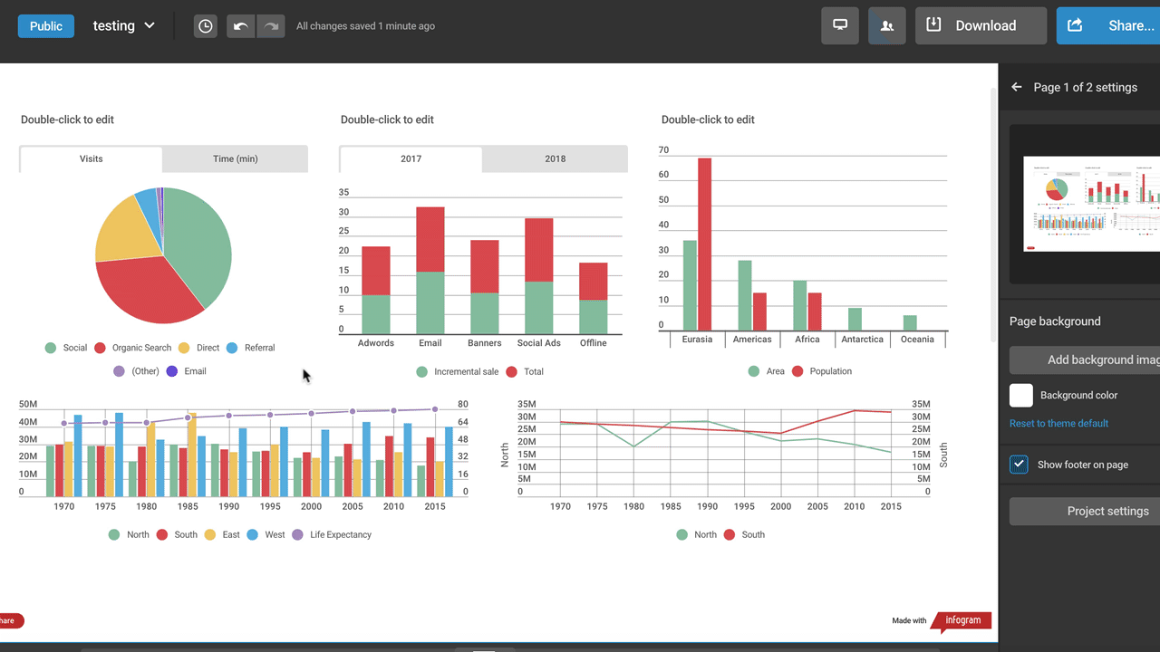
Offline Seminar #2
Visual Communications
Visualising Tools: Infogram
Free plan includes:
37+ interactive charts types
Up to 10 projects
Up to 5 pages per project
13 map types
Publishing your content online
Import data
Object animations
Great tutorials
https://infogram.com/pricing

Slide 43
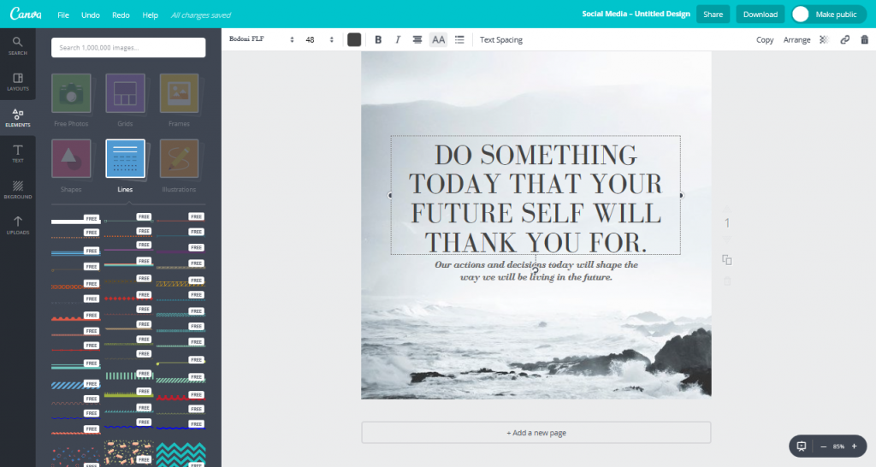
Offline Seminar #2
Visual Communications
Visualising Tools: Canva
Free plan includes:
Two folders to organize designs
1GB storage for photos and assets
Access to over 8,000 templates
Uploading your own images
Access millions of photos (paid)
Free subscriptions for nonprofits
https://about.canva.com/
pricing/

Slide 44
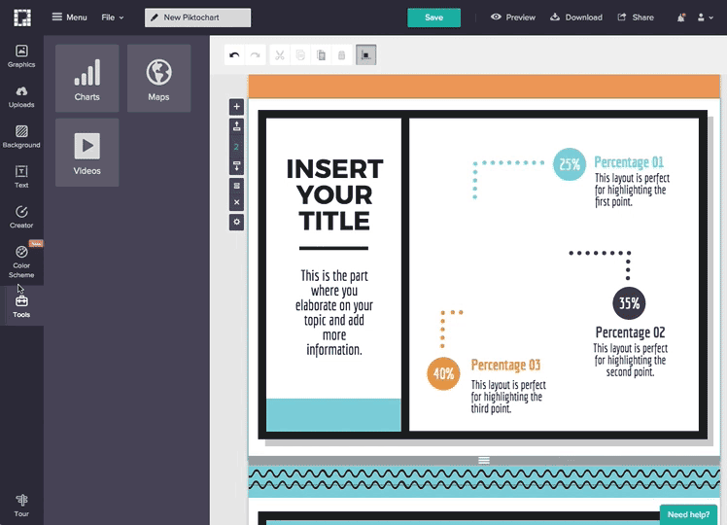
Offline Seminar #2
Visual Communications
Visualising Tools: Piktochart
Free plan includes:
Unlimited number of projects
Access to over 4,000 free icons and images
Share the works using built-in social sharing options,
Download the works as a JPG or PNG image
https://piktochart.com/pricing/

Slide 45
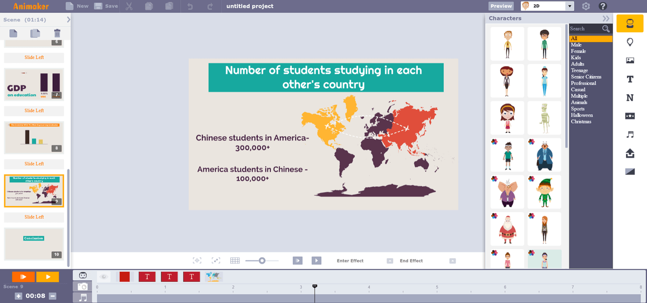
Offline Seminar #2
Visual Communications
Visualising Tools: Animaker
Free plan includes:
2 min video length
5 exports per month
Upload to YouTube in SD quality
Some characters, icons and maps
Import images and video
Text prebuilts
https://www.animaker.com/pricing

Slide 46




Thank you for your attention!
Contacts
Project Regional Office:
23 Grigorenko Av., Office 2505,
02068 Kyiv, Ukraine
+38 063 376 55 46
welcome@EaPCivilSociety.eu
www.EaPCivilSociety.eu
Trainer’s email: Iryna.Velska@EaPCivilSociety.eu
GDSI Office:
Block 15, Galway Technology Park
Parkmore, Galway, Ireland
+353 91 761000
consulting@gdsi.ie
www.gdsi.ie
Your questions are always welcome ☺

