Slide 1
E-services provided by civil society in Belarus
Open data and online services reusing open data and run by CSOs
Valeriya Volkogonova,
Office for European Expertise and Communications
Alina Radachynskaja
Open data initiative
Minsk, 2019

Slide 2
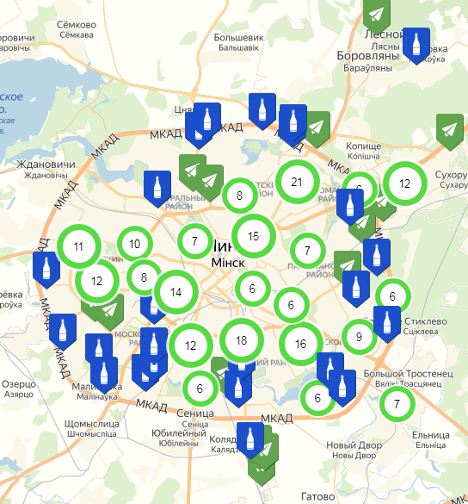
Interactive maps
Ecology:
https://www.watercontrol.by/
http://greenmap.by/
https://ecoidea.by/ru/zerowaste
Domestic violence:
https://karta-nasiliya.by/map/

Slide 3
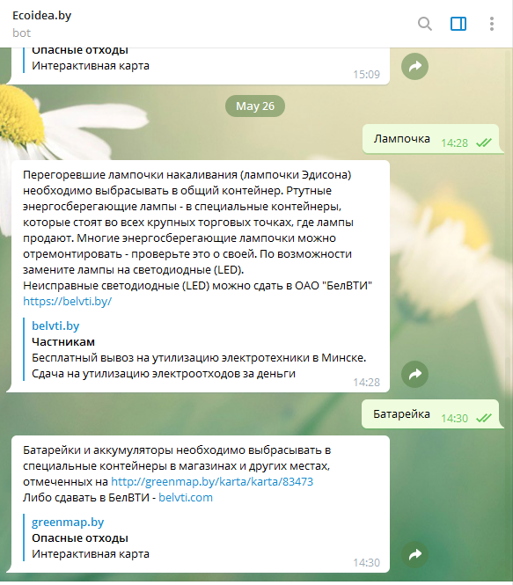
Chatbots
Waste segregation:
https://telegram.me/EcoideaBot
Civil control (parking):
https://telegram.me/parkun_by_bot

Slide 4
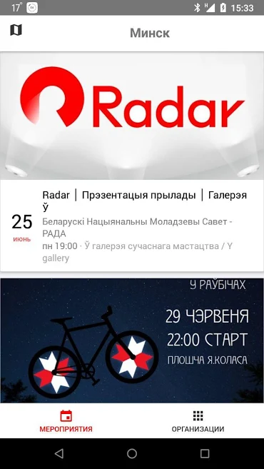
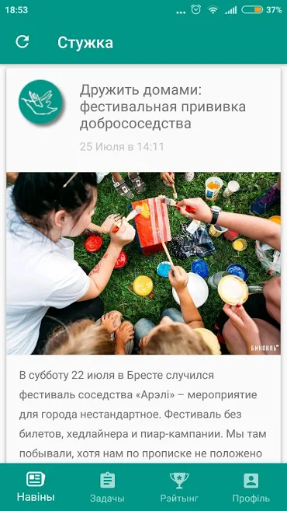
Mobile Apps
Youth initiatives:
Radar
https://play.google.com/store/apps/details?id=fm.rada.radar
“Be volunteer”
https://play.google.com/store/apps/details?id=org.dzedzich.volunteers

Slide 5
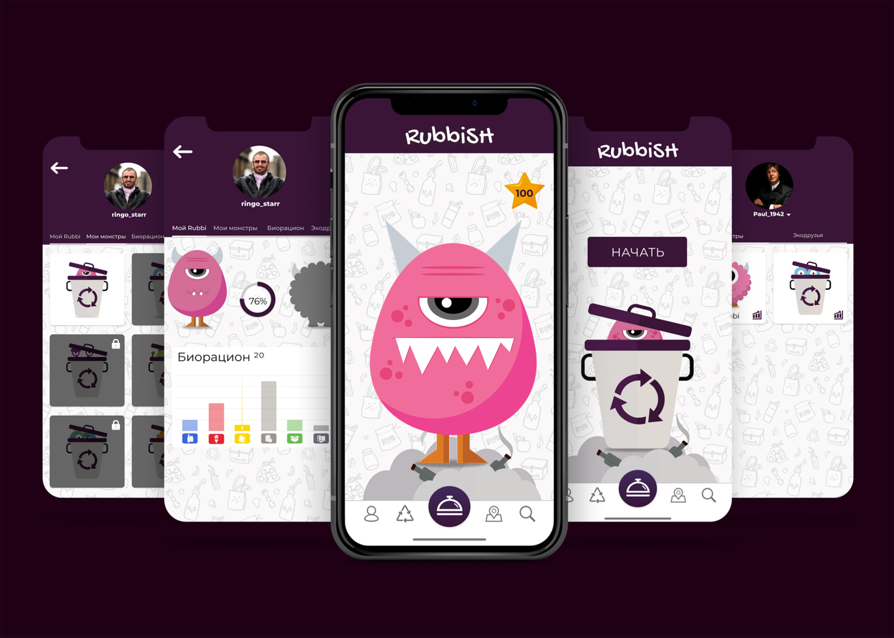
Gamification
Rubbish
http://rubbish.by/
Good Neighbours
http://dobrososedi.tilda.ws/

Slide 6
Fundraising
Crowdfunding
https://ulej.by/
https://molamola.by/
Donations
https://doika.falanster.by/
Crowdsourcing
https://www.talaka.org/

Slide 7
Podcasts
Centre for new ideas (thinktank)
https://ideaby.org/chernobyl-nexta/
Podcast about mental health
https://music.yandex.ru/album/7030764
FemFM
https://www.mixcloud.com/FemFM_podcast/

Slide 8
Sticker packs
https://t.me/addstickers/socialweekend
https://t.me/addstickers/ecoidea
https://t.me/addstickers/falanster

Slide 9
Interactive media projects
Zero Waste
http://zawtra.by/
Chernobyl (by Radio Svaboda)
https://docs.rferl.org/infographics/2016/2016_04/2016_04_Chernobyl/Chernobyl2.html
Belarus Future Index
https://ideaby.org/index-2019/

Slide 10
Interactive media projects
How to write about vulnerable groups
https://www.aboutpeople.info/
90’s.by
http://90s.by/

Slide 11
PigPug - AI Brain training system for mental health specialists
http://pigpug.co/
Civil tech StartUps from Belarus
deepdee - AI-driven solution to diagnose diabetic retinopathy
https://deepdee.org/
Donor.by - emergency donor search
http://donor.by/
Belarus startup ecosystem
https://media.dev.by/belarus-startup-ecosystem_rus.pdf
et al.

Slide 12
Recommendations
Don’t be afraid to try
Social media started only 15 years ago
Facebook - 2004,
Youtube - 2005,
Twitter - 2006,
Instagram - 2010
We can adopt best practices but we also can create our own

Slide 13
Open Data
Free of charge
Free of usage restrictions
Machine readable

Slide 14
Open Data sources
Official government portals
https://data.gov.ua/
https://data.gov.uk/
https://data-georgiagio.opendata.arcgis.com/
https://data.nasa.gov/
https://data.gov.by/#/?_k=2v51a6
https://opendatainception.io/

Slide 15
Open Data sources
International organisations
https://www.europeandataportal.eu/data/
http://data.un.org/
Corporate
https://www.google.com/publicdata/directory
https://movement.uber.com/?lang=en-US
kepler.gl

Slide 16
Open Data sources
NGO/Academia
http://hodp.org/
https://ebird.org/explore
Collaborative data maintenance
Open Street map
*Open Data Institute research

Slide 17
Examples
The Northern Fail app
An app built by a very angry Northern Rail customer Designed to give fellow Northern Rail customers access to historical data on fully or part cancelled train journeys to help in the fight against Northern Rails astonishingly bad service and poor value for money

Slide 18
Examples
СУД НА ДОЛОНІ
Analytical tool for finding, researching and visualizing court decisions
ДонорUA
Automated system of recruiting and managing blood donors, designed to promote the donor movement in Ukraine.

Slide 19
Examples
InnoCentive
InnoCentive is the global pioneer in crowdsourced innovation. We leverage the power of the crowd to help organizations of all sizes solve their critical business, scientific, and technical problems.
Red Cross Mobile Apps

Slide 20
Examples
Surveillance under Surveillance
Surveillance under Surveillance shows you cameras and guards — watching you — almost everywhere. You can see where they are located and, if the information is available, what type they are, the area they observe, or other interesting facts.

Slide 21
Belarus data sources
Belstat - the best we have
http://belstat.gov.by
Air quality
http://rad.org.by/monitoring/air.html
Open data community
http://bit.ly/data_sources
https://opendata.by

Slide 22
Thank you for your attention!
Valeria Volkogonova
vvolkogonova@gmail.com
https://www.facebook.com/vvolkogonova
Alina Radachynskaja
alina.radachynskaja@gmail.com https://www.facebook.com/radachynskaja
Contacts

